Slide 1

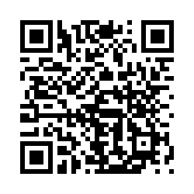
OFF-CAMPUS HOUSING
Here to help you transition from living
On-Campus to living Off-Campus
Please sign in using the following QR code:

Slide 2
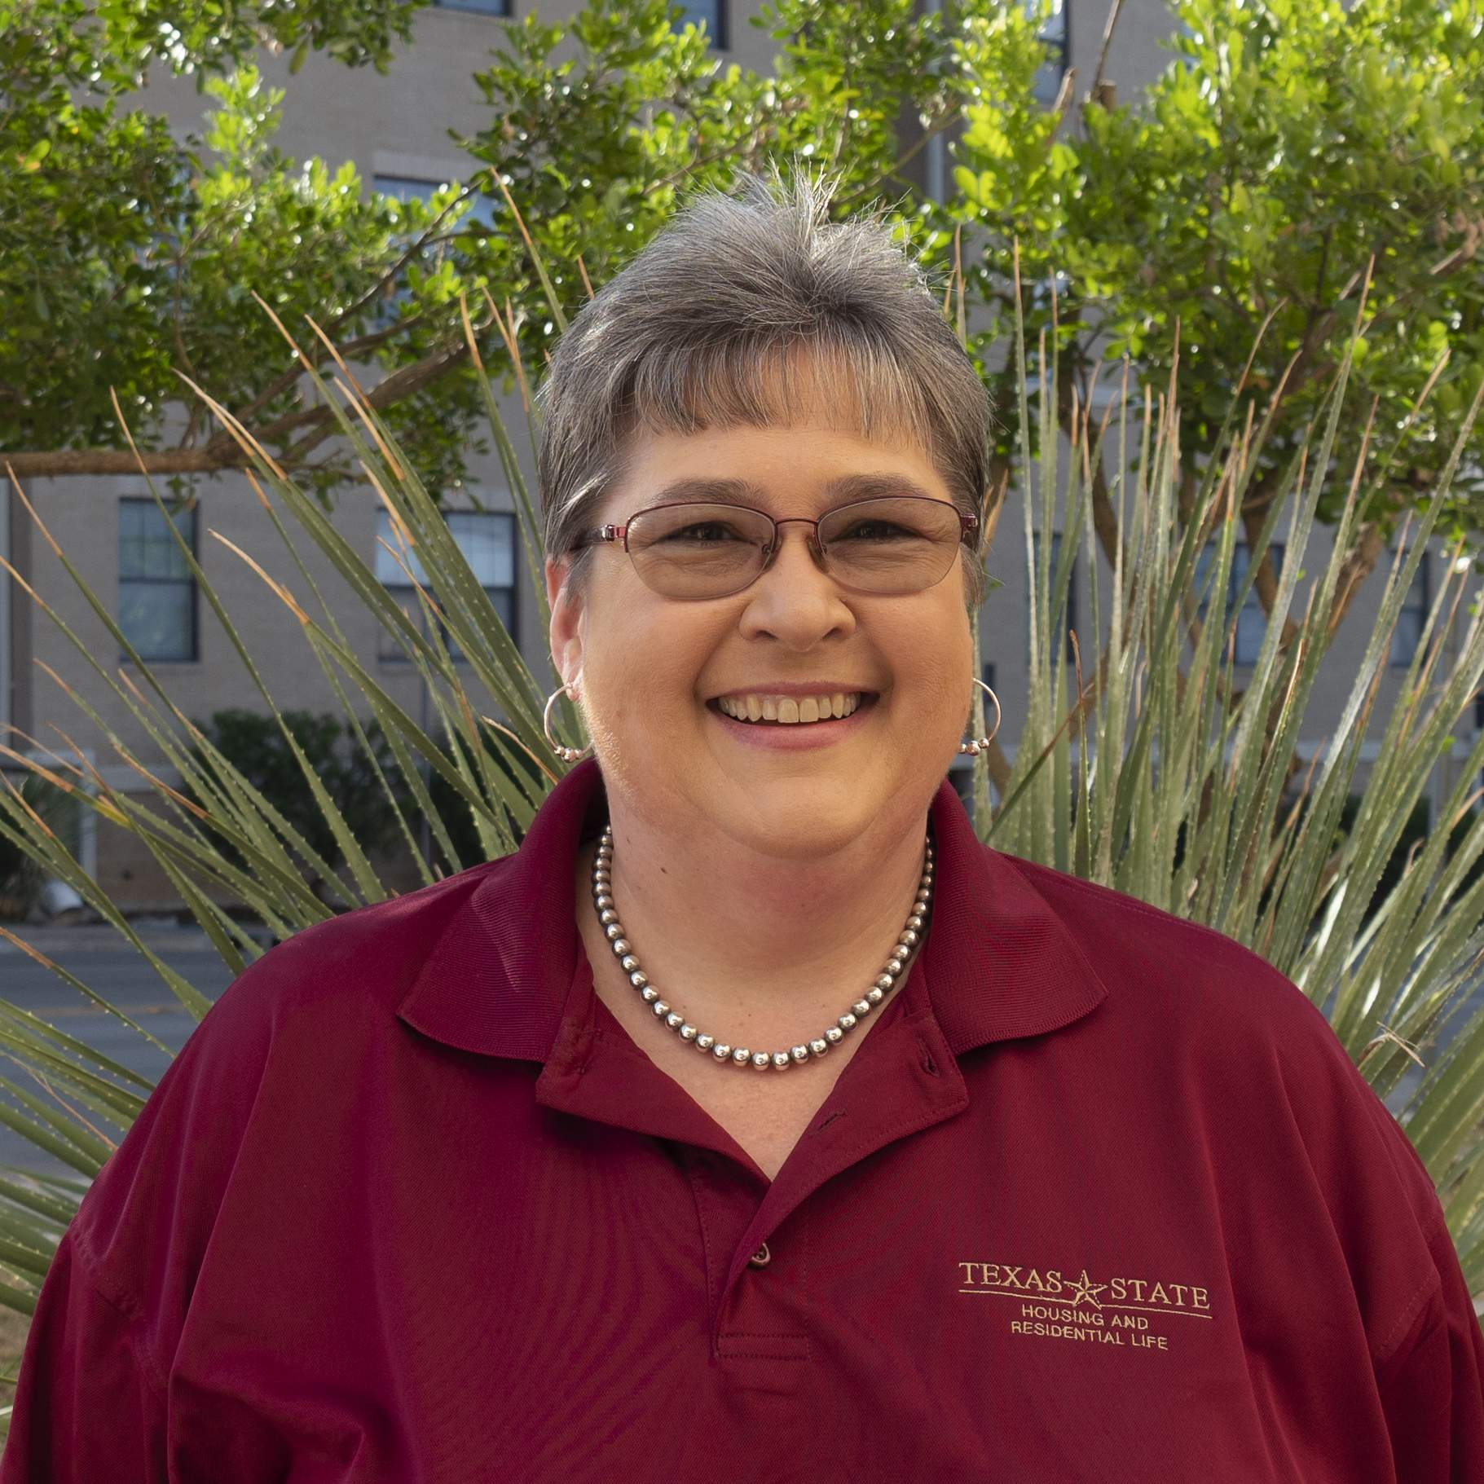





OFF-CAMPUS LIVING TEAM
MARGARET YACKEL
OSAS OMOROGIEVA
COORDINATOR FOR
OFF-CAMPUS LIVING
GRADUATE ASSISTANT
MARLEY TYLER
WILLIAM EUGENE-ONYEJIAKA
GABBY ROJAS
ALESSANDRA SANCHEZ
STUDENT ASSISTANT
STUDENT ASSISTANT
STUDENT ASSISTANT
STUDENT ASSISTANT

Slide 3

LOOK NOW, SIGN LATER
Returning spaces on campus are VERY LIMITED for next year!
When does your CURRENT residence hall contract end?
  Your on-campus contract ends AFTER the spring semester (24-hours after your last final in May 2023).
You should start looking for an apartment for the ‘23-’24 academic school year starting now.
Do not sign a lease for the academic ‘23-’24 school year until Spring—January or later!

Slide 4
WHAT WE’RE COVERING
HOW DO I FIND A PLACE TO LIVE?
MOVING IN
Maintenance & repairs
Bobcat safety
Being a good neighbor
Moving out
Additional resources
What is your budget?
Property requirements
Rental insurance
Types of leases
Lease start & end dates
Tips for signing a lease
Location & amenities

Slide 5

BUDGETING AND PRE-PLANNING

Slide 6

WHAT IS YOUR BUDGET?
How much can you afford monthly?
  Monthly Rent/Installment
  Budget extra for deposits and fees
  Budget for Renter’s Insurance
  Budget for moving expenses and extra apartment supplies and necessities
  Check to see if your Financial Aid can help pay for Off-Campus Housing!

Slide 7



CHOOSE WHAT YOU CAN COMFORTABLY AFFORD
Would you rather graduate and have lived in the nicest place possible, be closest to campus, and be in maximum debt?
OR
Would you rather graduate and have lived in a nice place
within your budget and graduate with less debt?
Do the math!
$500 rent x 12 months = $6,000
$1,200 rent x 12 months = $14,400

Slide 8

KNOW THE PROPERTY REQUIREMENTS
Most students will need a guarantor.
  A guarantor is someone with financial security that will be on the lease with the student.
  Most students will use a parent or guardian.
  Each complex has different standards for guarantors, including a 3rd party guarantor option.

Slide 9

WILL I HAVE TO PUT DOWN A SECURITY DEPOSIT?
If possible, it is better to put down a security deposit
WITH a Security Deposit
  Landlord has 30 days to inspect after move-out and return to you, minus any charges.
WITHOUT a Security Deposit
  Landlord has an extended time to charge you for damages after
  move-out.
Ask if there are any other fees so you can budget accordingly!
  Parking/Garage fee
  Monthly pet fee
  Application fee
  Green fee
  Activity fee
  Miscellaneous fees

Slide 10

IS INSURANCE IMPORTANT?
YES!
Insurance is very important and required at many rentals.
Renter's insurance is very affordable.
Bundle it with your auto insurance or parent's homeowners' insurance.
Inquire about:
  Renter’s Insurance
  General Liability Insurance
  Flood Insurance

Slide 11

SIGNING A LEASE

Slide 12
WHAT IS THE DIFFERENCE BETWEEN AN APPLICATION AND A LEASE?
APPLICATION
LEASE
The rental application is a form that requests preliminary information about the potential tenant including the income, background checks, and credit checks.
The rental lease is a legal binding contract. Once you sign it, you are financially responsible for the entire term of the lease.
An application and lease can both be completed online. Read before you fill things out.

Slide 13


DIFFERENT TYPES OF LEASES:
TRADITIONAL/CONVENTIONAL VS. INDIVIDUAL LEASES
TRADITIONAL/CONVENTIONAL LEASES
You are responsible for finding your roommates
Apartment is usually NOT furnished, all utilities are billed separately.
INDIVIDUAL LEASES
Each roommate signs their own lease
Apartment complex usually finds your roommates
Apartment is usually furnished and often provides internet and cable

Slide 14

INSTALLMENT PLAN VS. MONTHLY RENT
Installment Plan: most of the rent for individual leases are paid in installment plans.
  The total rent is divided into the contracted months and divided
  out evenly among the number of months in your contract. Each installment is usually due on the 1st of every month, even if you haven’t moved in yet.
  You pay for 12 months even though you will typically live there only 11.5 months.
Monthly Rent: most of the rent for the conventional
or traditional leases will be pro-rated by your
move-in date.
  The following months rent is usually due on the 1st of every month.

Slide 15


DO YOU PREFER A
HOUSE OR AN APARTMENT?
HOUSE
Usually more spacious
Usually offers more privacy
Usually has a yard
Utilities, internet, and cable are usually NOT included
City of San Marcos has occupancy restrictions
  Single-family zoning
APARTMENT
Amenities are included
Maintenence is included
Management is on-site
SOME utilities are usually included
Usually on a bus route or within walking distance to campus
Community environment

Slide 16
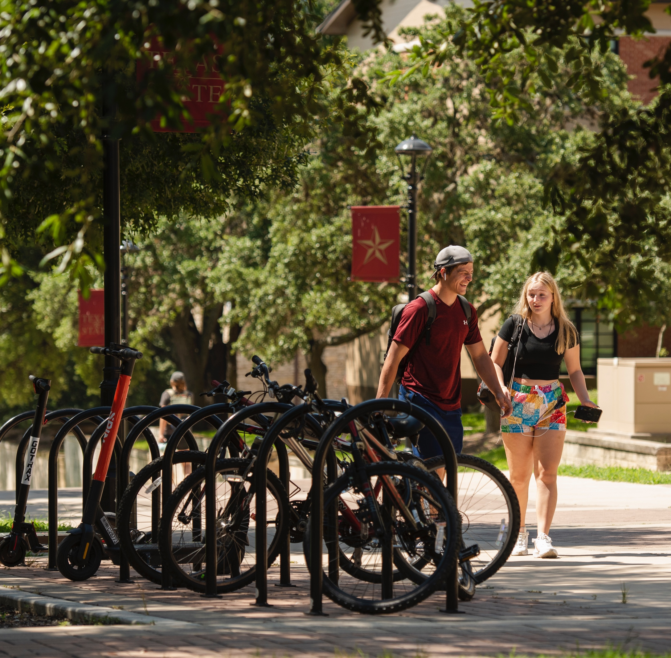
WHAT IS THE LOCATION AND WHAT AMENITIES ARE PROVIDED?
Location, location, location—how close is it to TXST and places that you frequent?
  Pick a location that is good for you and within budget.
How will you get to class?
  Walk or bike.
  Ride the bus.
What amenities are offered, and will you use them?
Does it come furnished?
  Couch, bed, desk, chair, etc.

Slide 17

KNOW THE PROPERTIES START AND END DATES
Many individual lease dates are not flexible.
  This is very important if you are planning to attend summer school at TXST.
Know the length of the lease before signing.
What are the move-in and move out dates and does that work with your schedule?
If you like where you live, consider staying!
  Moving costs money!
Will there be a gap between your leases?
If so, where will you be living?
Where will you store your belongings?

Slide 18
TIPS BEFORE SIGNING A LEASE
DO
DON’T
Stick to your budget.
Know the length of the lease.
Research current reviews online.
Get everything in writing.
Visit the properties and ask questions.
Be cautious when visiting a property that is under construction.
Sign multiple leases for multiple properties.
Rush the process.

Slide 19
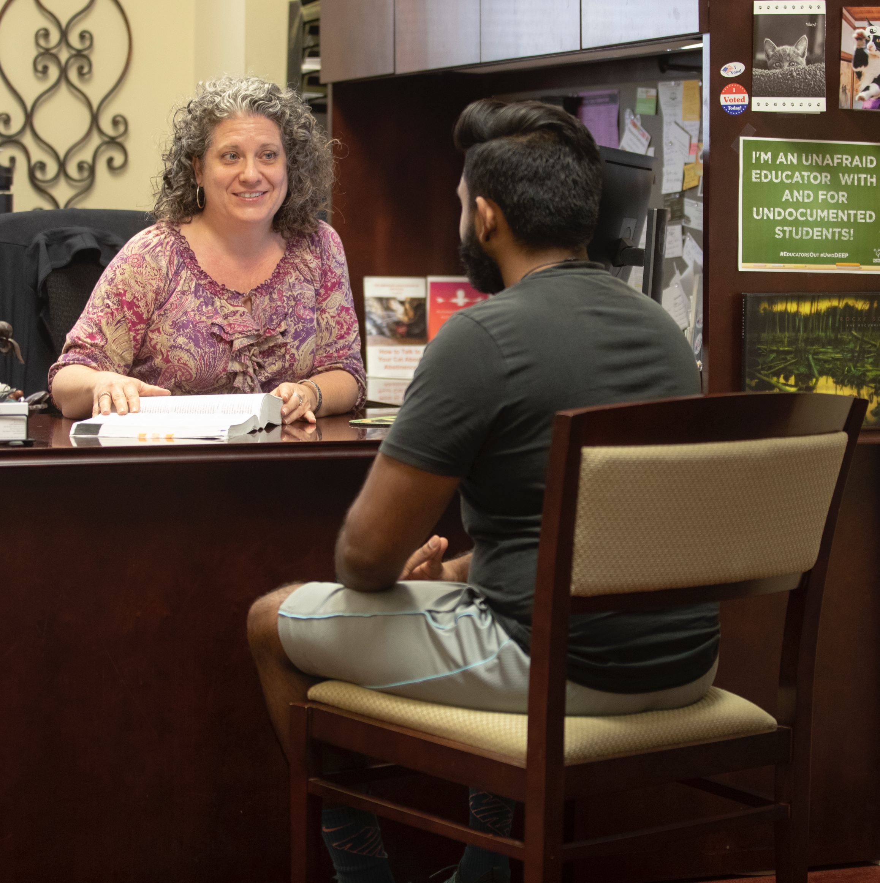
MAKE AN APPOINTMENT WITH THE ATTORNEY FOR STUDENTS
It’s no extra cost! It's already paid for with student fees.
Located on the 5th floor of the LBJ Student Center.
Before signing a lease, consider making an appointment to meet with them and review:
  An unsigned lease
  A list of move-in costs
  A list of move-out costs
  A copy of all addenda

Slide 20
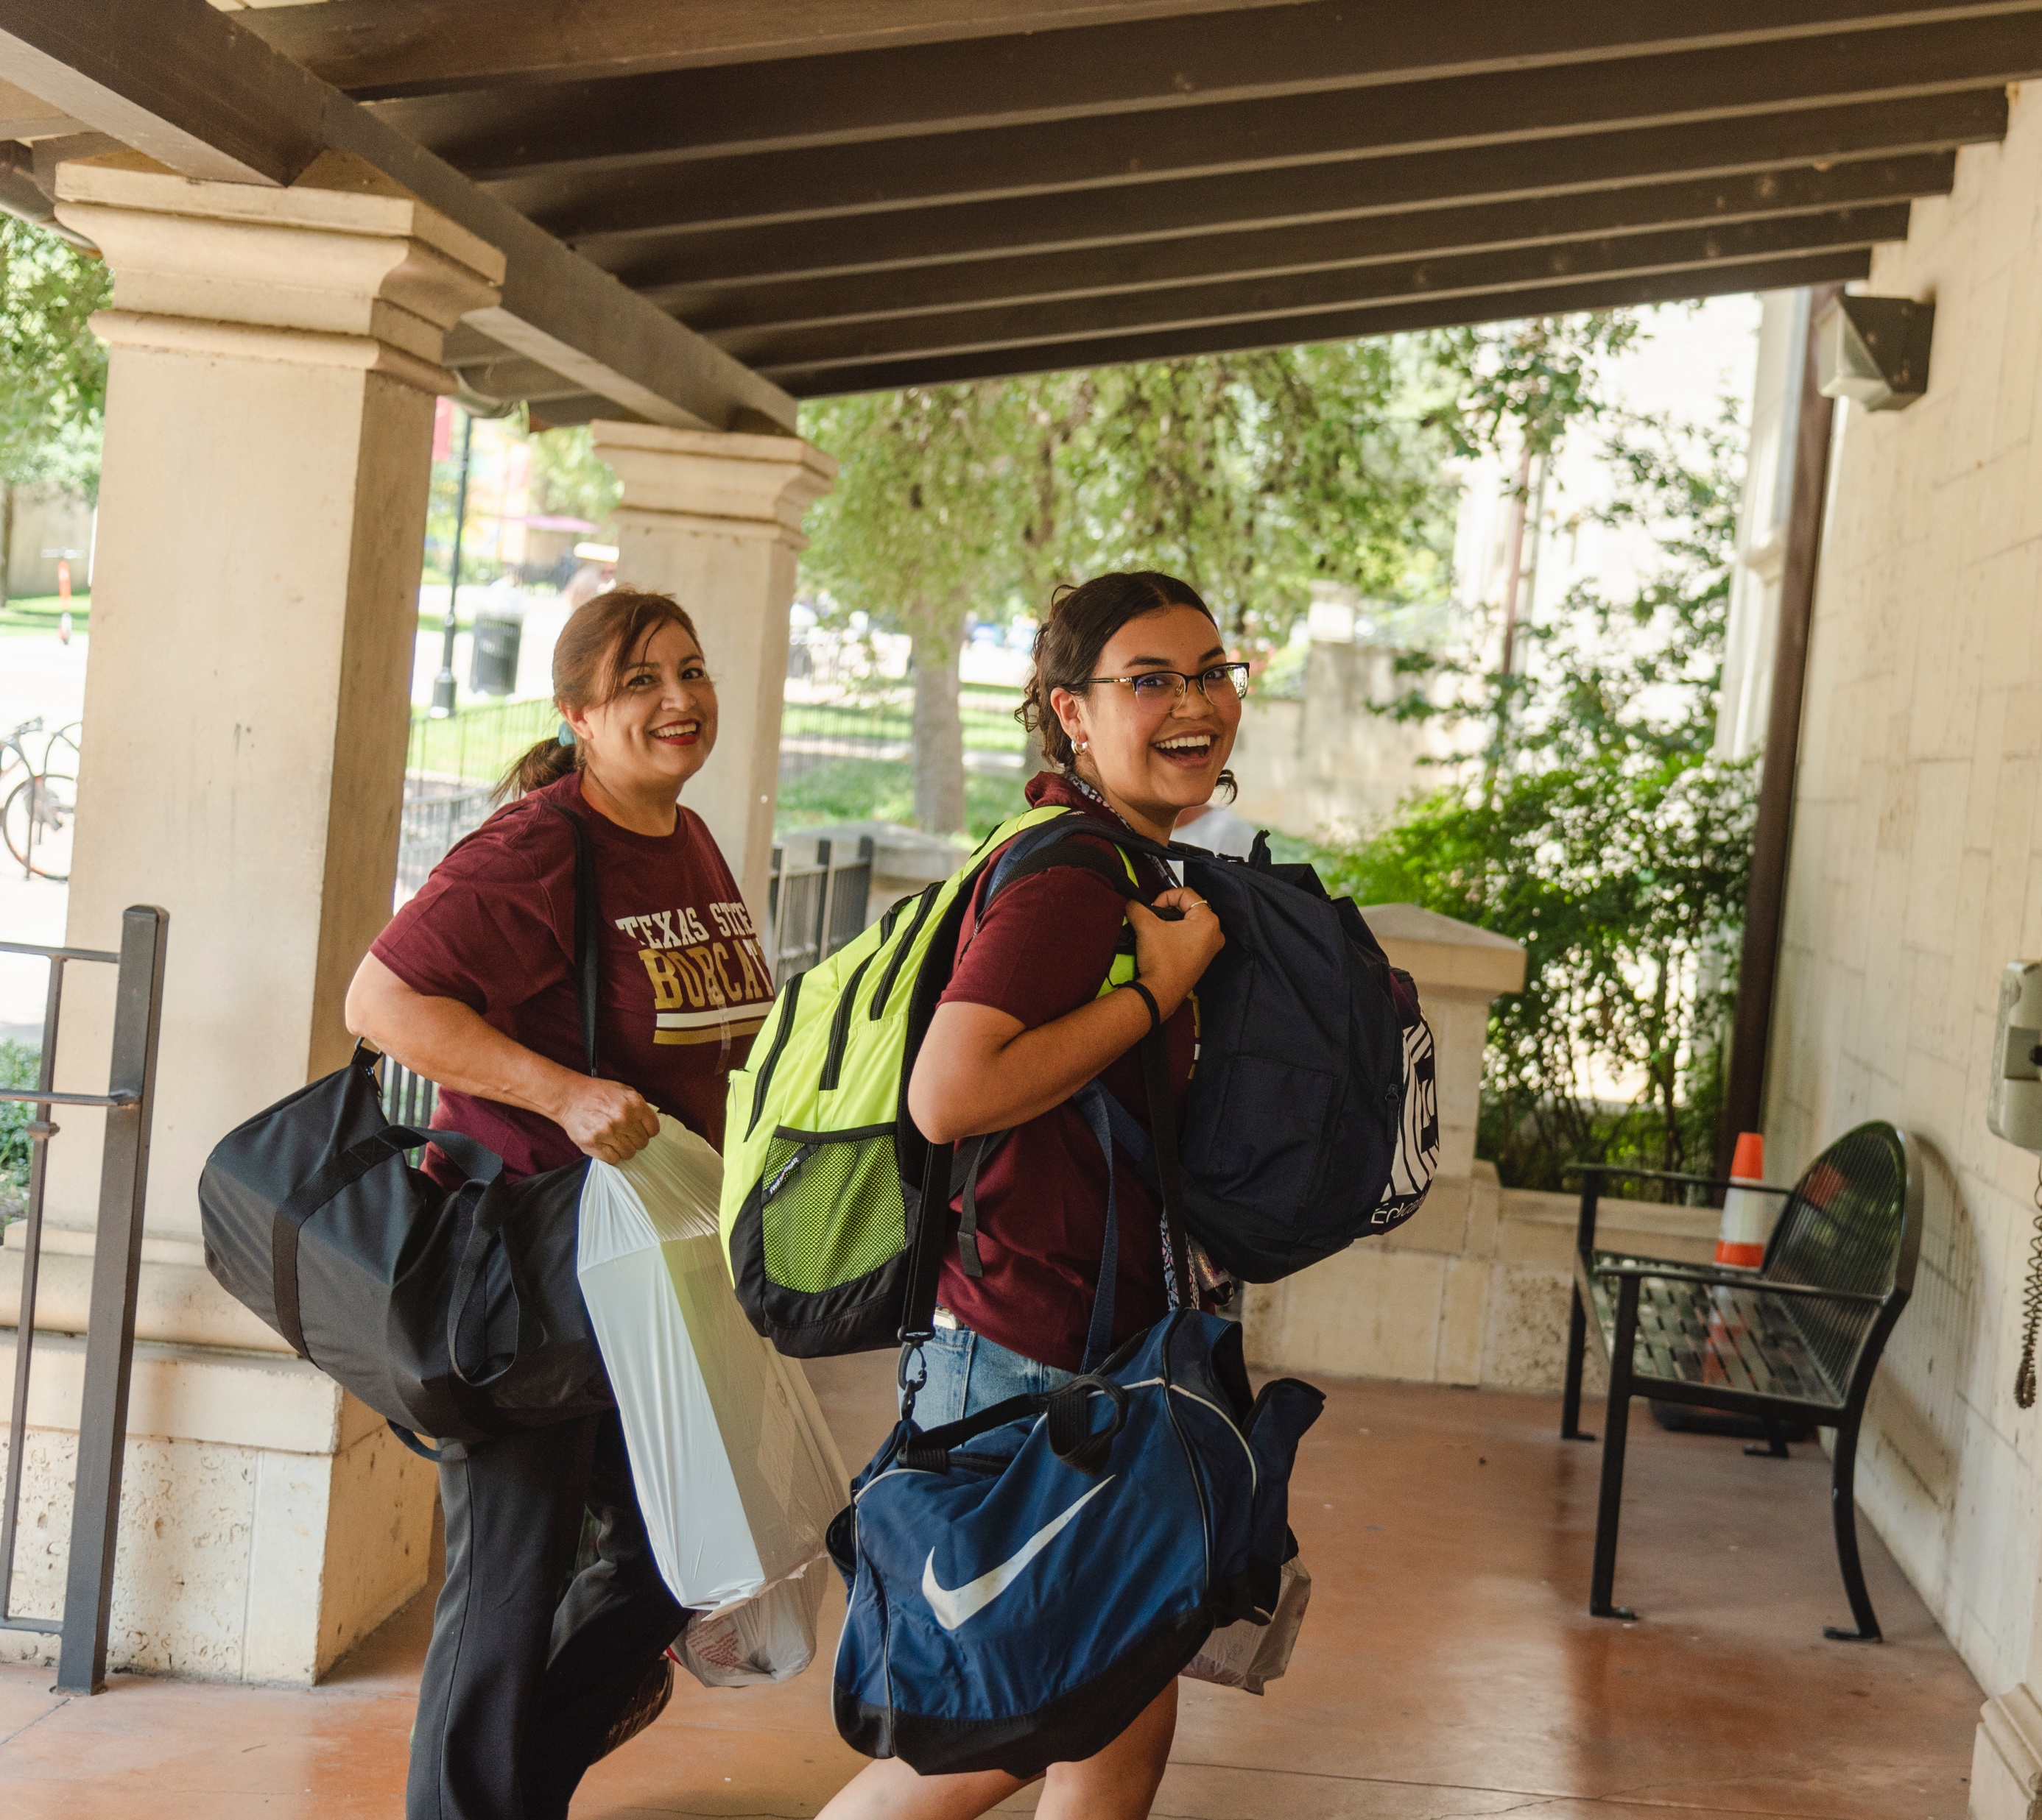
MOVING IN AND OUT

Slide 21
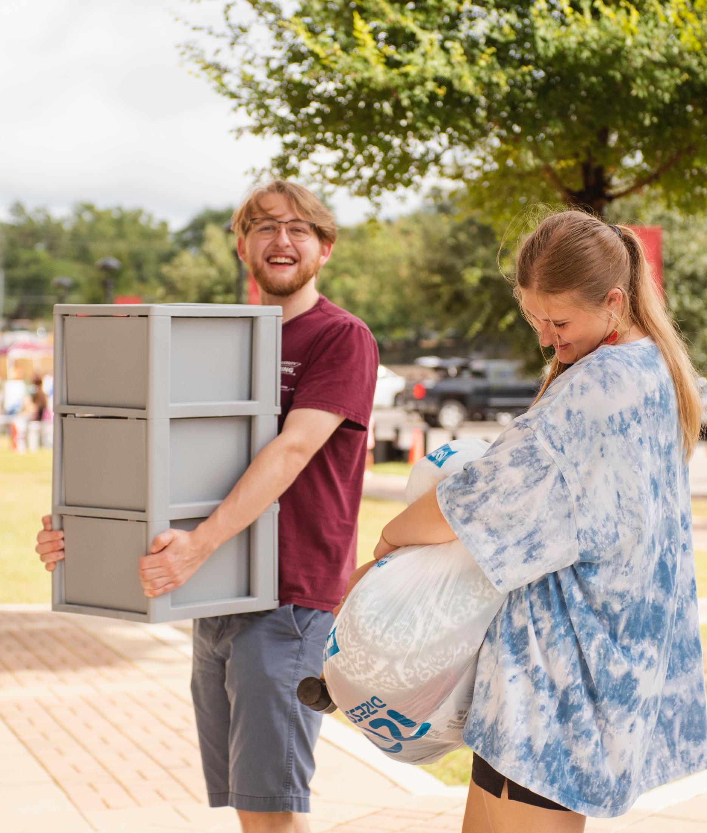
MOVING IN
Take pictures and videos of the apartment and email them to yourself.
Be detailed and specific when completing your apartment condition form. Report maintenance items separately and keep a copy for your own records.
Make sure your water, electricity, and gas are turned on and in your name.
Consider using a utility sharing service to divide the bill between roommates.

Slide 22
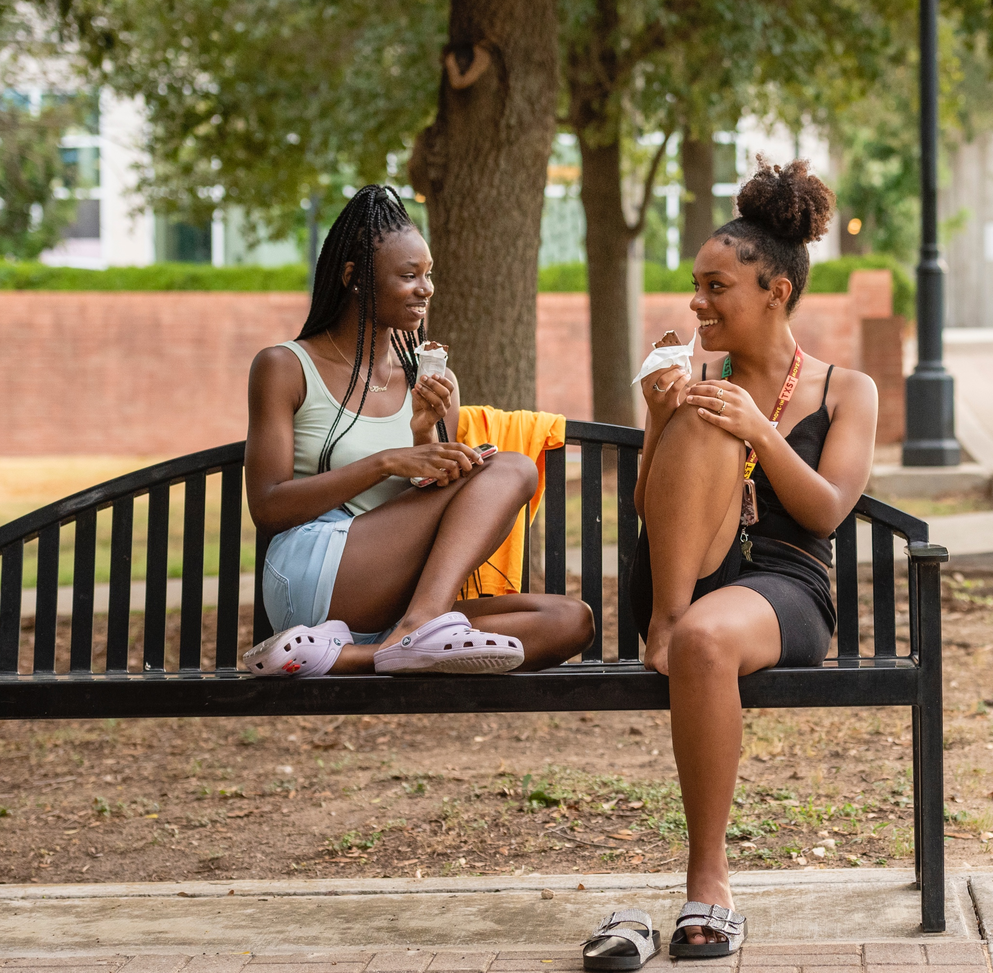
ROOMMATE MANAGEMENT
Establish standards that everyone agrees upon:
  Create a roommate agreement
  Cleanliness
  Quiet Times
  Space
  Groceries
  Visitors
  Respect
  Communication

Slide 23

MAINTENANCE AND REPAIRS
When submitting maintenance requests, send them in writing through the US Postal Mail. This is the only way that Texas law recognizes your request.
Never withhold rent!
You did NOT sign a lease that said “I’ll pay the rent until something breaks”.
If you don’t pay, you still will be responsible for late fees which could lead to an eviction.

Slide 24
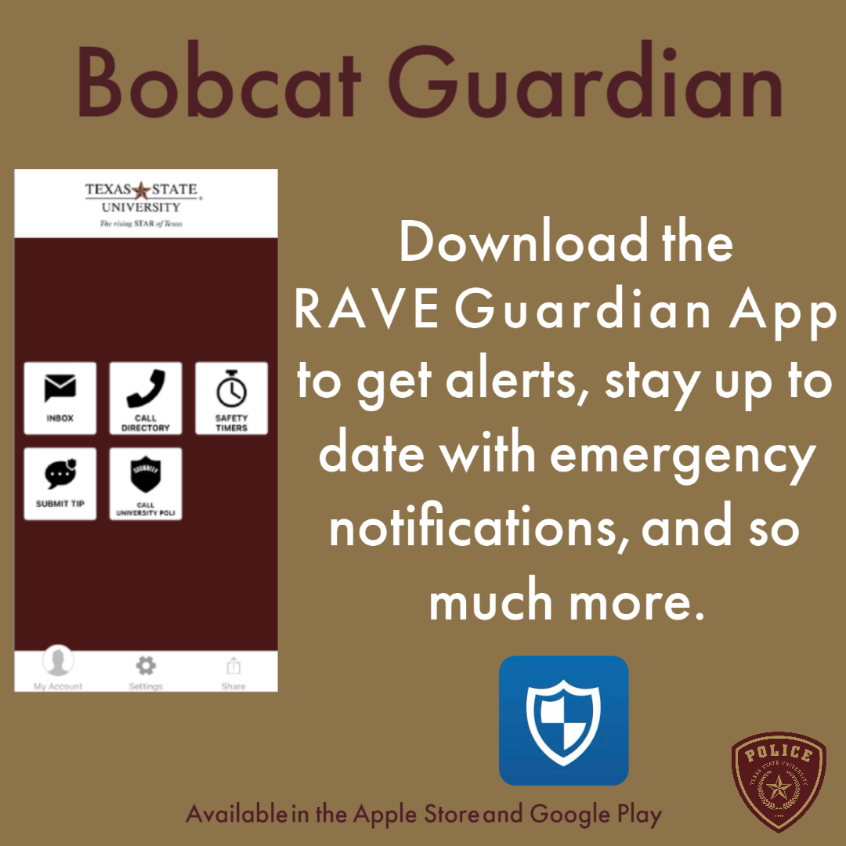
BOBCAT SAFETY
Use the Bobcat Guardian App.
Lock doors and windows—this includes sliding doors!
Wear bright or reflective clothing when walking or running after dark.
Let a friend or roommate know when you are leaving, where you are going, and when you will be back.
Check the batteries on your smoke detector and replace
as needed.
Questions to ask yourself:
  Does your space have sprinklers and fire extinguishers?
  Do you have a fire escape plan?

Slide 25
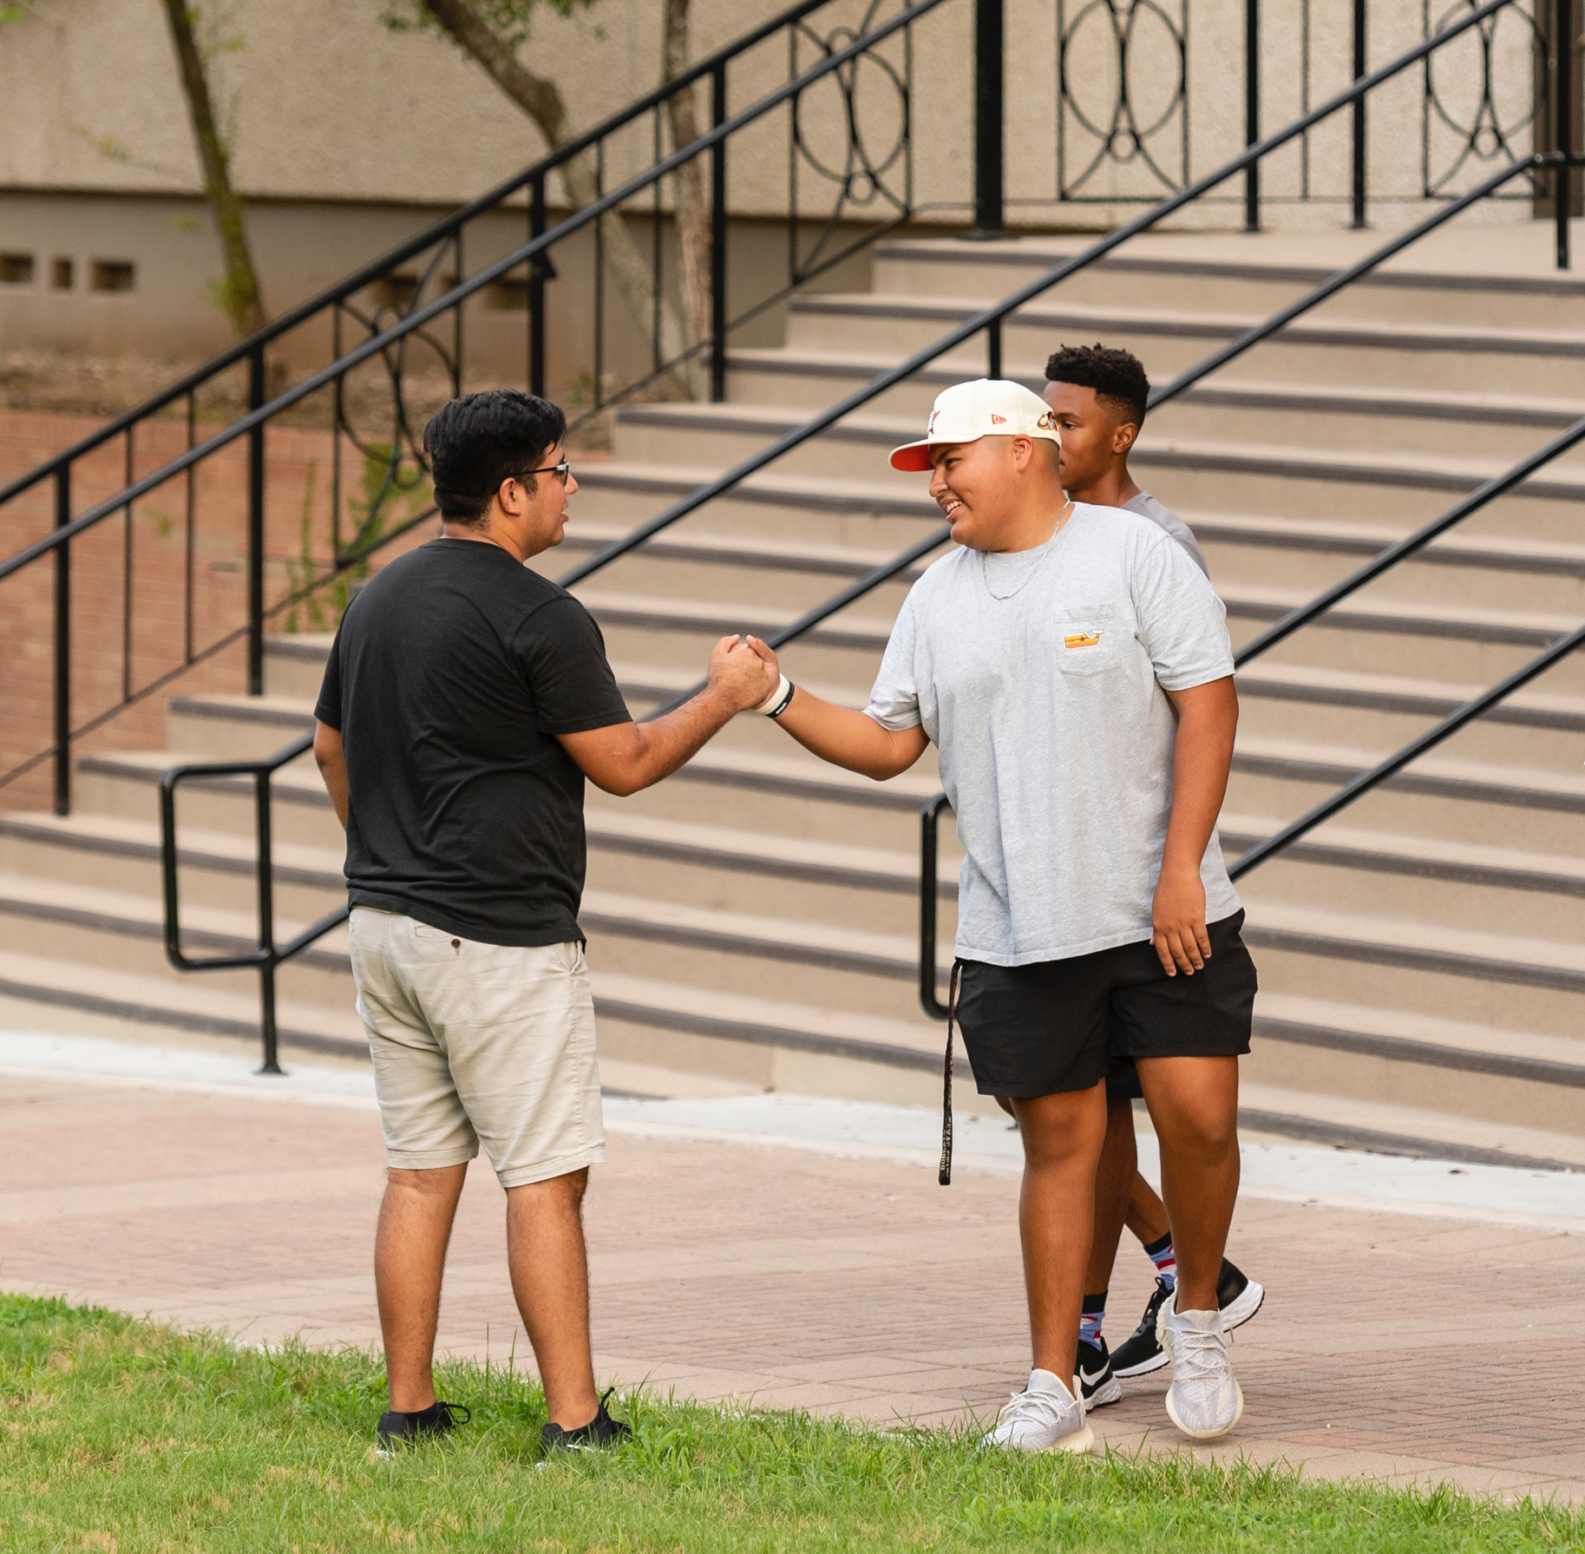
BE COMMUNITY AWARE &
A GOOD NEIGHBOR
Introduce yourself to your neighbors—you never know when you might need a favor.
Know your noise level and how loud is too loud?
Know parking regulations on- and off-campus.

Slide 26
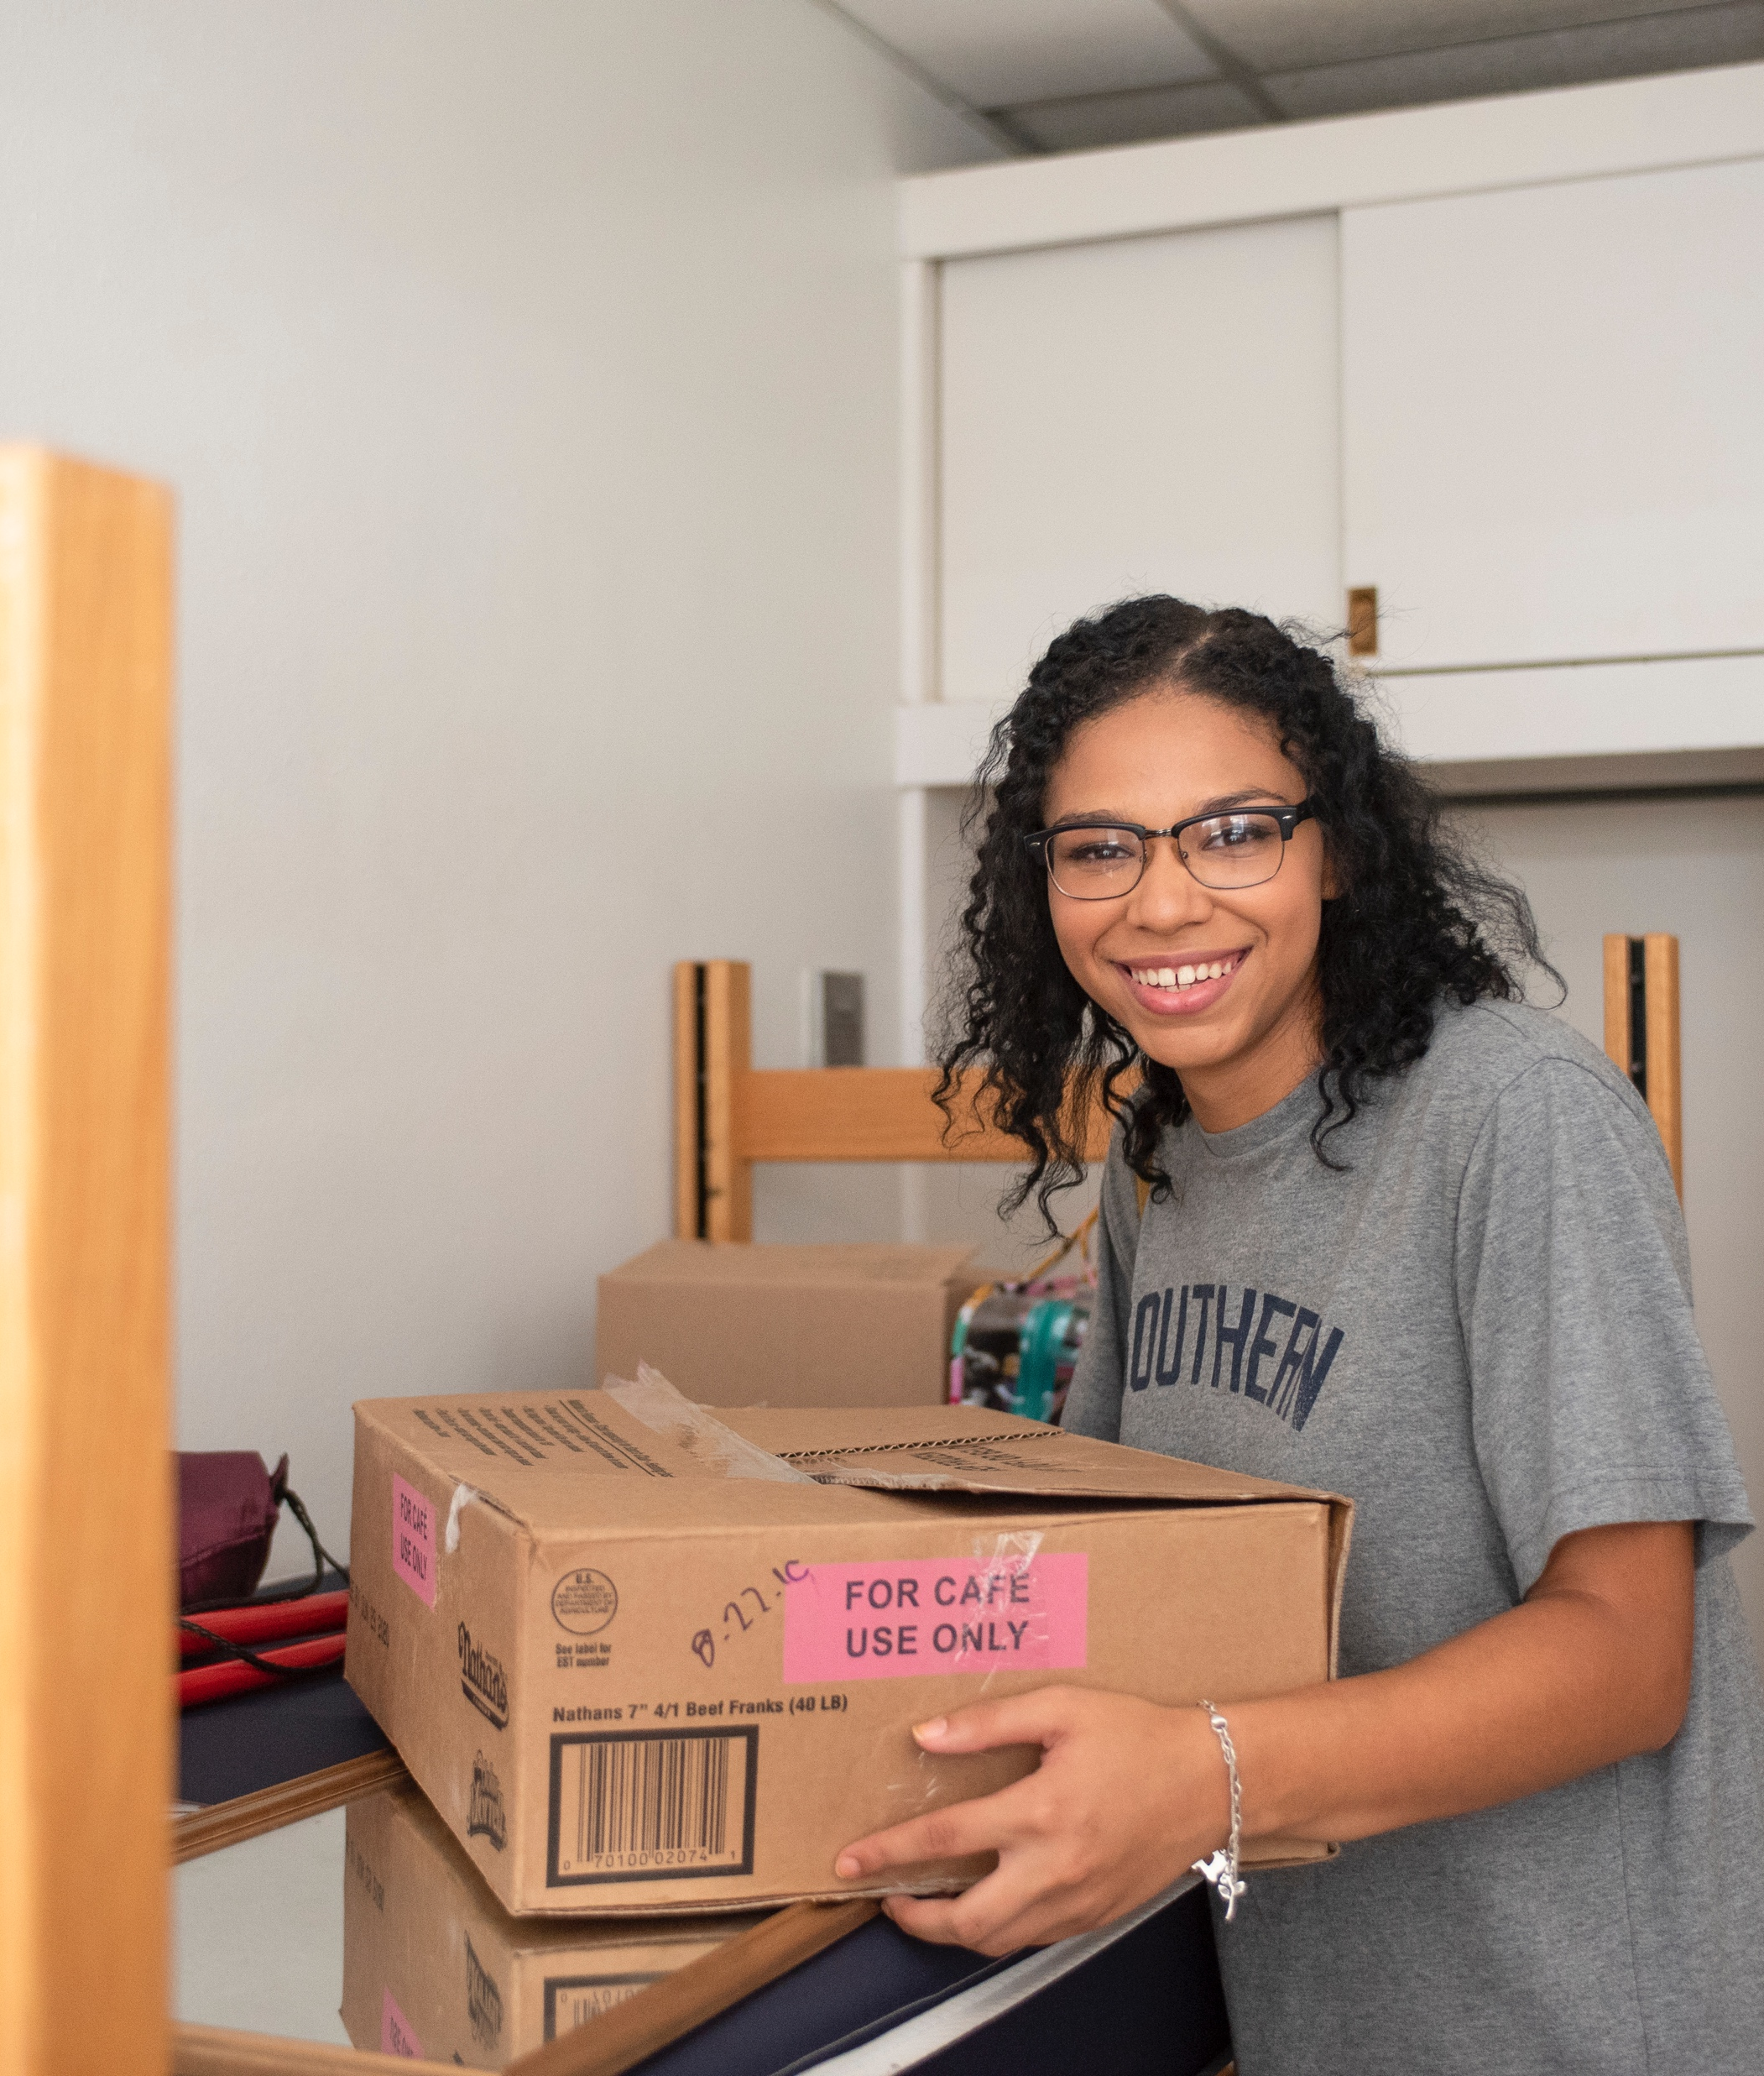
MOVING OUT CHECKLIST
Know when your lease ends.
Complete a notice to vacate letter, if required.
Request a bulky waste pick up, if needed.
  For furniture and big items.
Clean the apartment! Most apartments will give you a detailed list of what needs to be cleaned.
Take video/pictures of the final condition. Compare it with your move-in photos and videos you took.
Do NOT leave anything in the apartment when moving out. You will be charged a haul out fee.
Schedule a walk through.

Slide 27
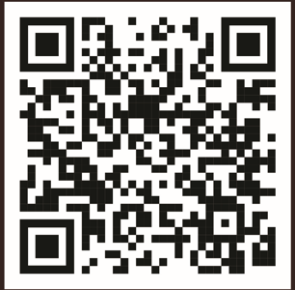

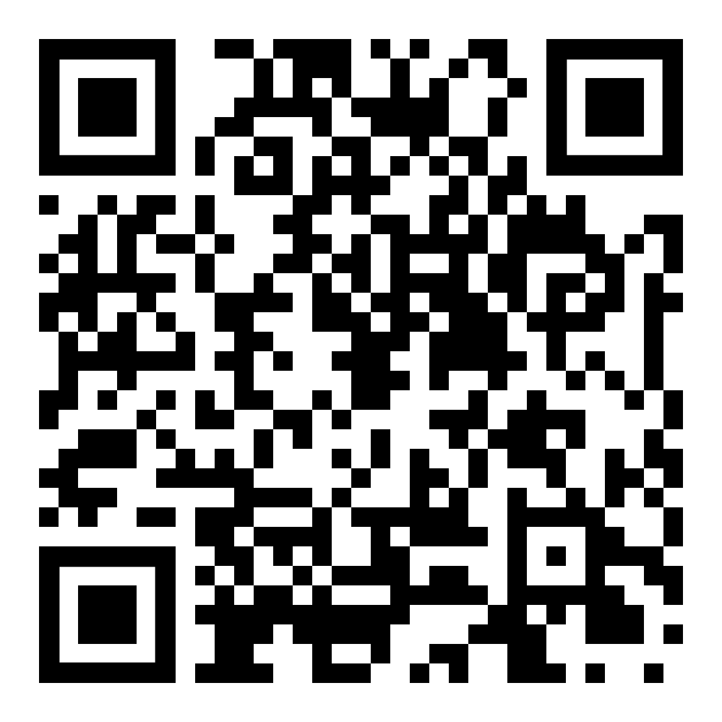

RESOURCES
Off-Campus Housing Marketplace
offcampushousing.txstate.edu
Guide to Living Off-Campus
reslife.txst.edu/off-campus/guide
CONTACT
offcampusliving@txstate.edu
512.245.5595

Slide 28

LET’S TEST YOUR KNOWLEDGE!
KAHOOT!
Notes:
NEEDS THE KAHOOT LINK FROM OWNER

Slide 29
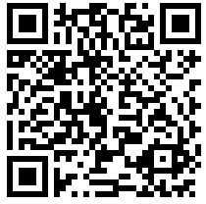
QUESTIONS & FEEDBACK
Please scan the QR code
to complete the feedback survey

Slide 30
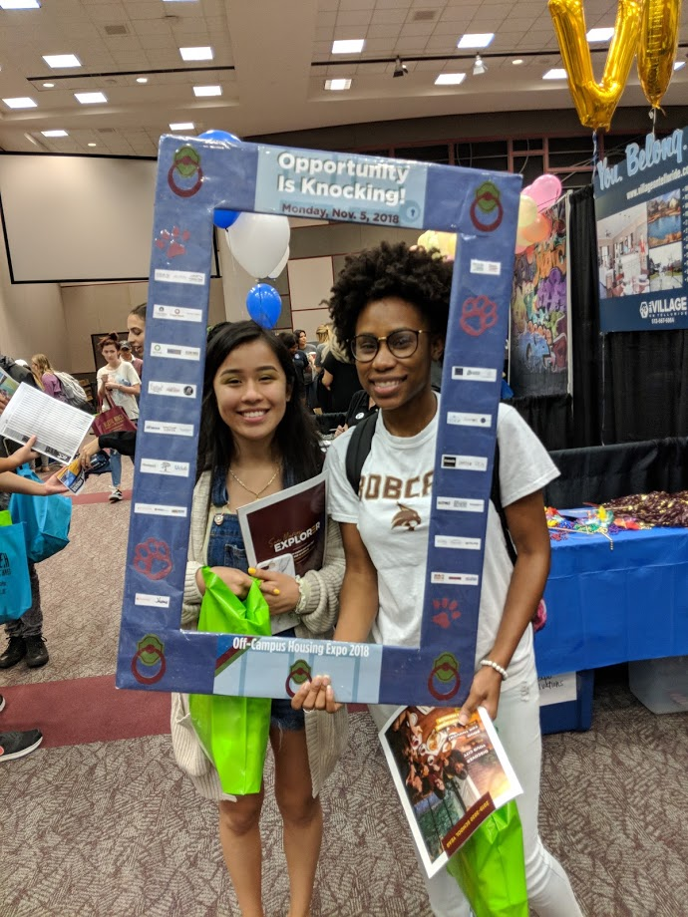

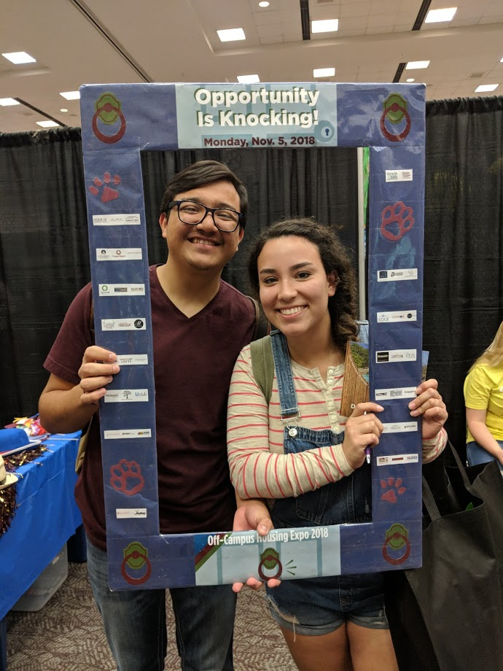

THANK YOU!
Come visit apartment properties on-campus at the
Off-Campus Housing Expo
Monday, February 6, 2023
LBJSC Ballroom

