Slide 1


Understanding the Electronic
PCR Process
Notes:
Production
https://ibis.sap.txstate.edu/irj/portal
RQ2
https://iqis.sap.txstate.edu/irj/portal
RS2
https://isis.sap.txstate.edu/irj/portal

Slide 2
Understanding the Electronic PCR Process
Training modules and materials are available on the Faculty and Academic Resources and HR Data Management Team websites.
Electronic PCRs are created in the SAP Portal, which is accessible through the Texas State homepage.
To access the Electronic PCR tab, you must have the Department Head security role. This role is approved on a limited basis and reserved only for Department Heads and their administrative support staff.
Department Head security role supports the organizational unit the position is in or the org units below.
The Department Head security role is position based and is inherited by the new employee when they are hired into a position with the Department Head role.
To request Department Head access, click on the SAP Access link at: https://itac.txstate.edu/forms.html

Slide 3
Electronic PCR Processing
Faculty and graduate student appointments in Academic Affairs are processed by Faculty and Academic Resources .
Staff (hourly and salaried), hourly student workers, and graduate student appointments in all other divisions are processed by Human Resources.
PCR Deadlines & Resources

Slide 4
What You Need to Know
  Support documents must be attached electronically as separate documents using the naming convention in the Document File Name Guide.
  Documents can be attached by the initiator and/or the approvers.
  Direct deposit and paperless W2 enrollment can be setup by the employee in SAP Employee Self Service the day after their PCR is approved.
  The COMMENTS section on the PCR must be completed by the initiator in order to send to the first approver.
  Any initiator or approver can print a copy of the PCR prior to clicking on the SEND or APPROVE button should they wish to retain a hard copy.
  Faculty and Academic Resources and the HR Data Management Team (processors) cannot change the type of PCR but can modify the data fields if enough information is provided (such as an effective date or a change in an account number.)

Slide 5
What You Need to Know
  If the incorrect type of PCR is submitted the PCR will be rejected by the processor and the department will be required to submit the correct type of PCR form.
  If the attached support documents are not correctly completed or attached using an incorrect file name, the PCR will be rejected. The initiator can then attach the corrected form and resubmit the PCR for processing.
  PCR routing for approval is not available during the period that payroll is locked for processing. A hard stop message will be received. The PCR can be created and saved as a draft. Once payroll is unlocked, the initiator can access the draft under in the SAP Portal in the My Inbox tile.
  When a PCR is rejected, the initiator and anyone who has already approved the PCR will receive an email notice. The initiator will be able to see these actions in the HCM Processes and Forms Overview.

Slide 6
I-9’s and E-Verify
Employees must provide documentation to their employers to show their identity and authorization to work.
All I-9’s must be completed in Hire Right. To request HireRight access and obtain training, please contact Talent Acquisition at 512.245.8200.
Texas State University HireRight Information
Hiring departments will access the HireRight website to complete the I-9 and E-Verify process.
The department will upload the support documents in HireRight that were used on the I-9 by the employee. Form I-9 Acceptable Documents (USCIS)
Section 1 of the I-9 must be completed no later than the 1st day of employment; Section 3 no later than 3 business days from 1st day of employment.

Slide 7
Graduate and International Student PCRs
  All Graduate Students
  The department/office is responsible for obtaining and attaching an approval from the Graduate College for the following, if the justification for the approval is not attached, the PCR will be rejected by The Graduate College.
    Approval for an appointment greater than 50%.
    Approval for enrollment in less than nine graduate hours during the fall or spring semester or less than 3 graduate hours during the summer. If the student was enrolled in nine graduate hours the preceding spring and fall semesters, an approval is not needed for summer enrollment.
    Approval for enrollment in more than 12 graduate level hours during the fall or spring or more than 6 hours during the summer semester.
    Salaried Graduate Student Employment policy
    Graduate Assistant E-PCR Checklist
  International Students
  The department/office is responsible for obtaining and attaching an approval from the International Office for the following:
    Approvals needed for:
      Initial employment of an international student.
      An international student enrolled in less than nine graduate hours in the fall and spring semester only.
    https://www.international.txstate.edu/Work-Authorization/oncampus.html
    If a dummy SSN is needed for PCR processing, please contact hr@txstate.edu.

Slide 8
Other Useful Information
  If a former employee is rehired and has had a name change since last employed, the PCR will be created under the old name and processed under the old name unless a copy of the new social security card is attached to the PCR. If not attached, the employee must provide a copy of their new social security card to HR or Faculty and Academic Resources to support the name change.
  The types of PCRs and their purpose can be found in the PCR Desk Aid on the Faculty and Academic Resources website and the HR Data Management Team website under the Electronic PCRs tab.

Slide 9
Other Useful Information
  Before starting a PCR, you will need to obtain New Hire Support Documents from the employee. The forms are available: https://www.hr.txstate.edu/forms.html. You will attach these forms to the PCR.
  Employees that attend NEW do not need these documents attached to their PCR.
  You must attach the required documents to the PCR for new hires, rehires, or additional appointments for hourly students, hourly staff, task worker staff.

Slide 10
Other Useful Information
  Hourly student and hourly staff (NSNR) positions are created by the HR Data Management Team. If you need to hire one of these employees and do not have a vacant position available, please reach out to: hr_mdc@txstate.edu for assistance.
  Benefit-eligible positions are created through the audit process in People Admin. https://www.hr.txstate.edu/compensation/jobclassification/jobaudits.html
  SAP GUI transactions to view positions within your organizational unit:
    PPOSE
    ZHRPOSRPT
  NSNR instructions: https://www.hr.txstate.edu/mdc/staff-pcr/hiring-nsnr-steps.html

Slide 11
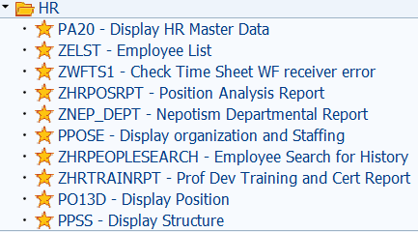
Helpful SAP GUI Transactions
  ZRWT3 - Remote Work Agreement Dept. Rpt.
  ZHRRETELIG - Retirement Eligibility Report
  ZTRKHRSSTU - Tracking Hours Worked Student
  ZWFHCM6 - HCM Forms (PCR) Monitor

Slide 12
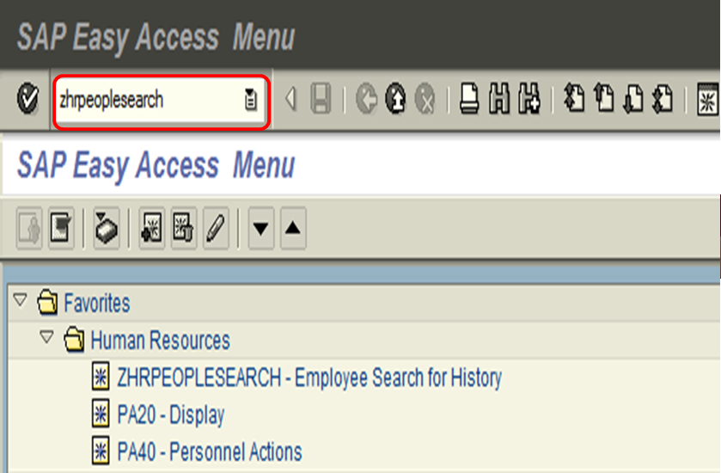
Steps to be taken before creating a Hire or Rehire PCR
  STEP 1
  Determine if the employee is new to Texas State.
  Log into SAP and enter ZHRPEOPLESEARCH in the search text box to determine if the employee is new to Texas State, a previous employee, or a current employee.

Slide 13
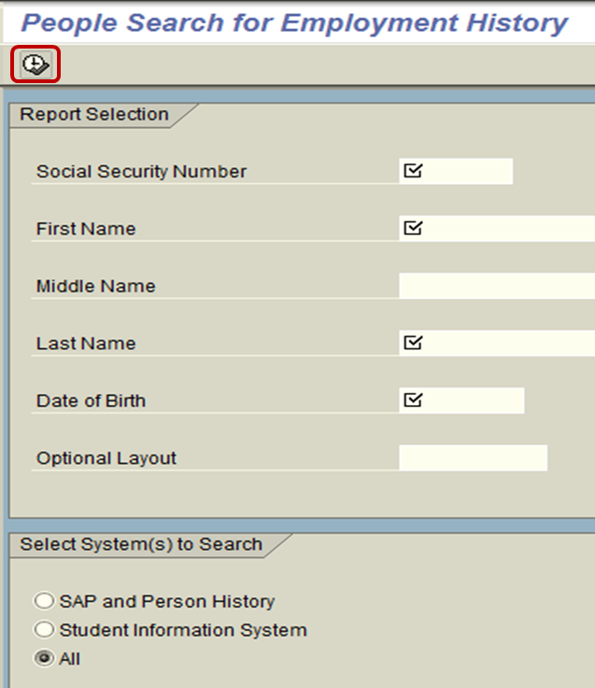
Steps to be taken before creating a Hire or Rehire PCR
  Enter the employee’s social security number, legal First Name, Middle Name or initial, Last Name, and Date of Birth.
  Click the execute button to populate the employment history.

Slide 14
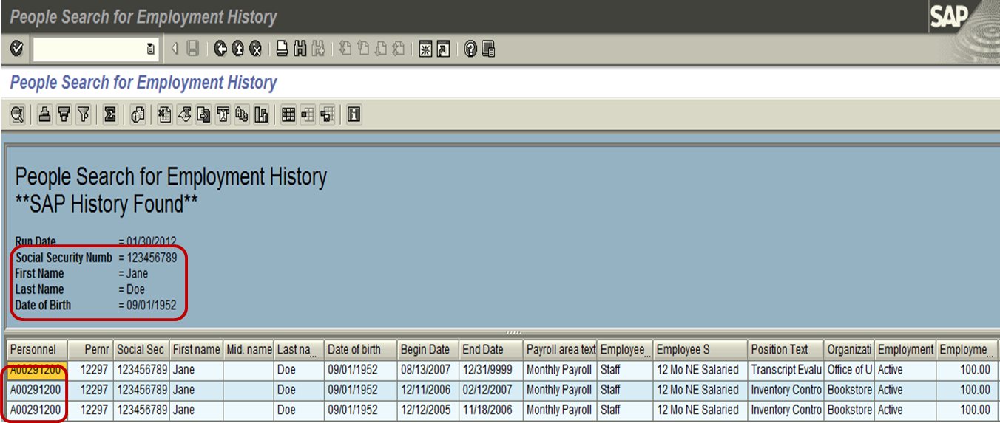
Steps to be taken before creating a Hire or Rehire PCR
  If a record exists for the person, the following screen and information will appear. If the title appears as **SAP History Found**, the individual has either a current or previous work history record in SAP and the New Hire or Quick Hire PCR is not used to appoint the person. Make note of the individual’s Person ID, Pernr, and Net ID.

Slide 15
Steps to be taken before creating a Hire or Rehire PCR
  If the message returned is **Person History Found** or **SIS History Found**, the individual’s employment is treated as a new hire in SAP. A Person ID number will be displayed.
  Record the Person ID number; you will use this number when the New Hire or Quick Hire PCR is selected.
  Make note of the assigned Net ID, if one exists. You will need to remind the employee of their previous Net ID.
  If a Net ID does not exist, you will request one through the Net ID Request website.
  If the message returned is “No History Found** the individual is new to Texas State and you need to create the Person ID (PLID) and Net ID for the new employee through the Net ID Request website.
  A Person ID and Net ID must also be created for Non-Pay employees.

Slide 16
Steps to be taken before creating a Hire or Rehire PCR
  STEP 2
  Before creating a New Hire/Quick Hire or Rehire/Quick Rehire PCR you must log into the NetID Request website:
    (1) To create the Person ID (PLID) and Net ID for all new salaried staff, faculty, and non regular, non-student staff (NSNR);
    (2) To reactivate a previous Net ID for an individual who is being rehired;
    (3) To create a missing Net ID for an individual found in ZHRPEOPLESEARCH; or
    (4) To create a PLID and Net ID for an individual who needs access to university resources prior to the actual hire date.
  This program is not used for student employees.
  The initiator is responsible for entering the legal name with middle name, if available, to ensure correct Net ID creation.
  The PLID and Net ID Request instructions are available on the Faculty and Academic Resources and HR Data Management Team websites.

Slide 17
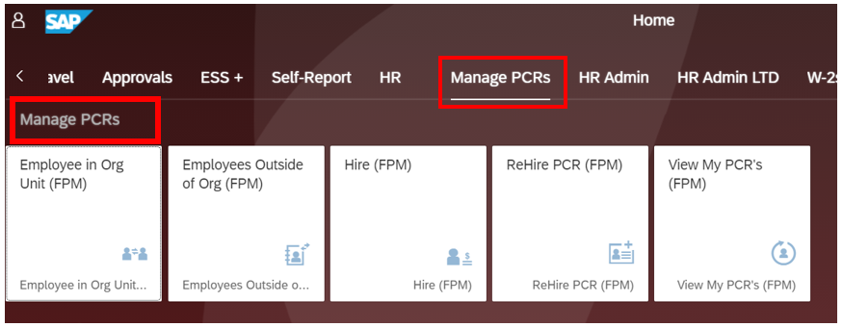
Steps to access the Electronic PCR
  Log into the SAP Portal
  Click on the Manage PCRs link or scroll through the page until you find Manage PCRs.

Slide 18
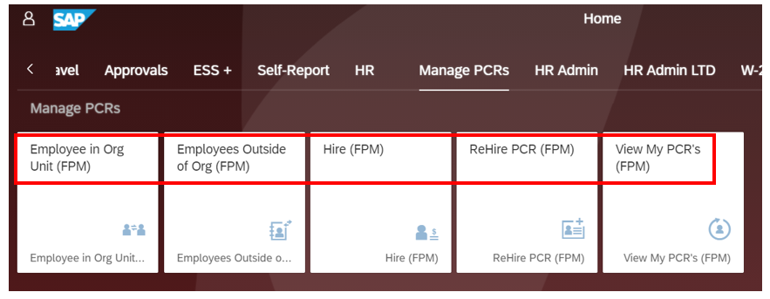
Steps to access the Electronic PCR
  Select an Option
  Employees in Org Unit: Current employees within your own department
  Employees Outside of Org Unit: Current employees working in another department
  Hire: person has never worked at Texas State in any capacity
  Rehire: a former employee of the university who has been separated
  View My PCR’s: View PCRs initiated by you

Slide 19
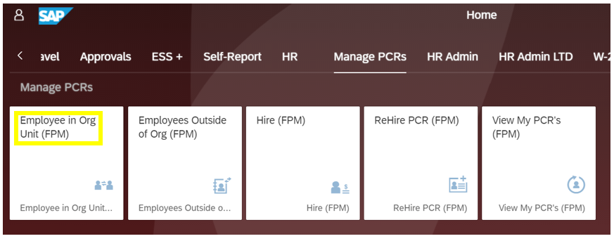
Employees in Organizational Unit
To view current employees within your own department, click on Employee in Org Unit

Slide 20
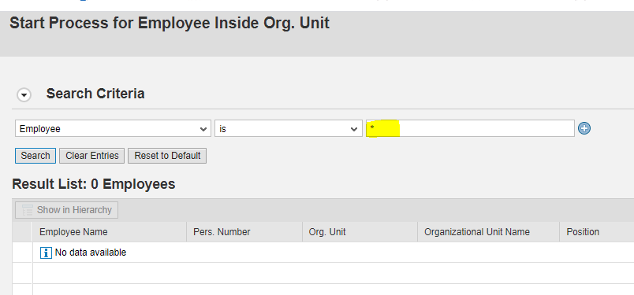
Employees in Organizational Unit
  You can Search for a specific employee using A0# or Personnel number. You can use the “*” to pull up all employees in your department.

Slide 21

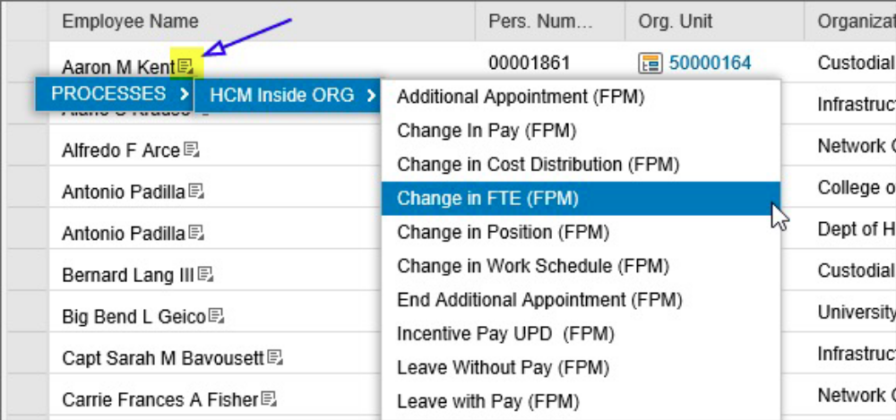
Employees in Organizational Unit
  Select the employee by clicking on the icon next to the person’s name.
  Select “Processes”
  Select “HCM Inside Org”
  Select PCR type

Slide 22
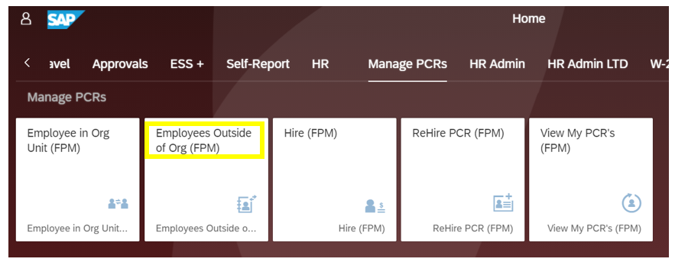
Employees Outside of Organizational Unit

Slide 23
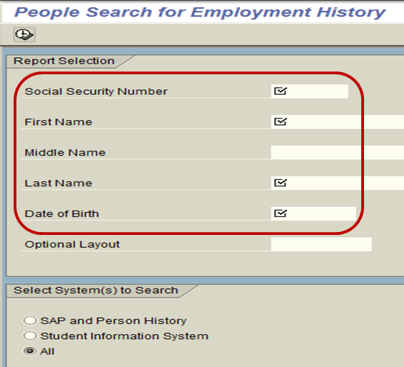
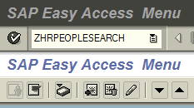
Employees Outside of Organizational Unit
  You must first log into SAP GUI and enter the transaction ZHRPEOPLESEARCH before creating the PCR.
  Enter the employee information. All data fields must be populated.
  Wildcard (*) can be used if not sure on spelling.

Slide 24
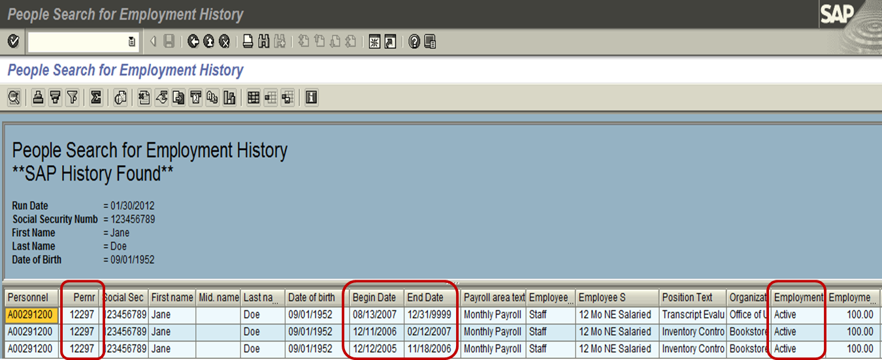
Employees Outside of Organizational Unit
  The information returned in this transaction will assist you in determining which Pernr is active, if the employee has more than one, and if the action you intend to perform is allowable by policy. If multiple assignments exist, the first step is to ensure the correct Pernr is selected.

Slide 25
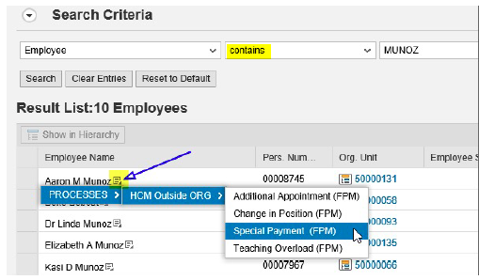
Employees Outside of Organizational Unit
  The initiator will enter the employee’s A0# or employee’s name and press the Search button. Pernr and “*” are not allowed. Use “Contains” if using the name.
  Start the PCR by clicking in the Icon next to the person’s name.

Slide 26
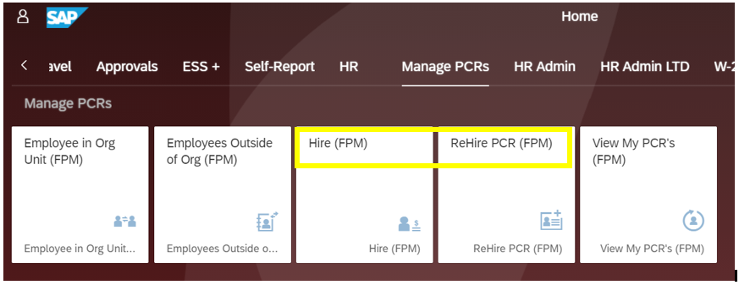
Hire and Rehire Process

Slide 27
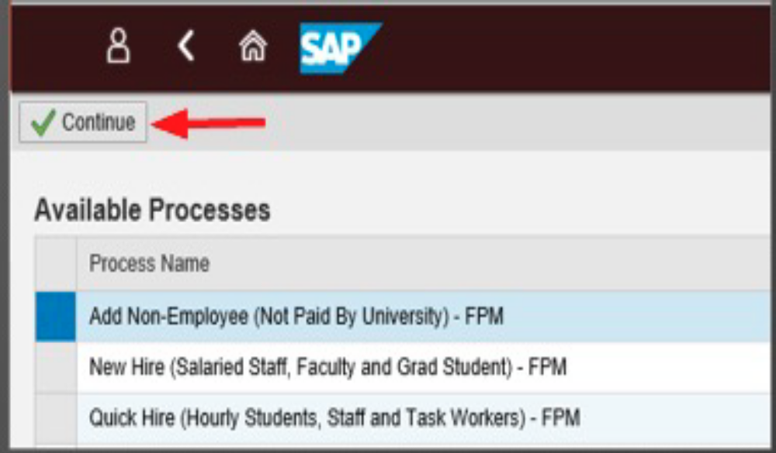
New Hires – Which PCR Do I Use?
  Add Non-Employee is used to appoint an individual who is not paid by the university
  New Hire is selected to appoint an employee into a salaried position
  Quick Hire is selected to appoint an employee into an hourly or task position. Task positions are only applicable for exempt level duties.
  Select Continue once you have selected the type.

Slide 28
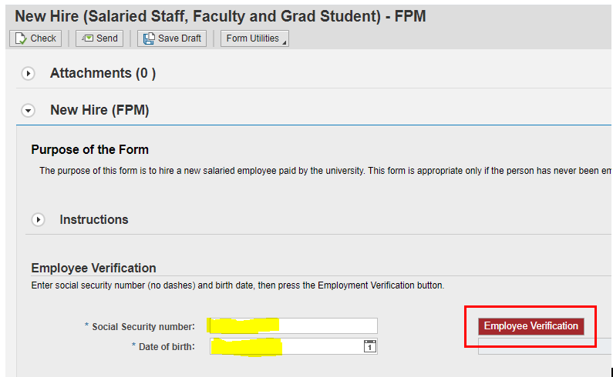
New Hire
  Enter the Social Security number and Date of Birth; click on the Employee Verification button.
  The employee’s information will populate based on the entry made in the PLID and NetID creation website.

Slide 29
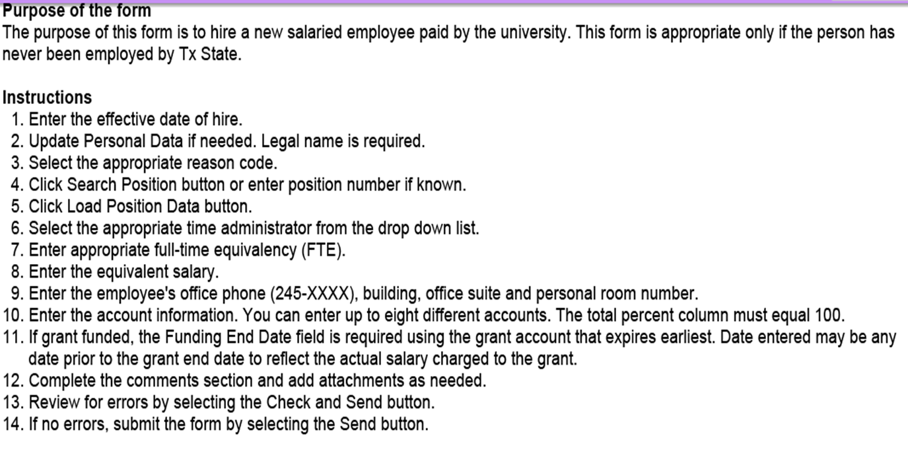
New Hire
  The purpose of the form and instructions are included on every PCR

Slide 30
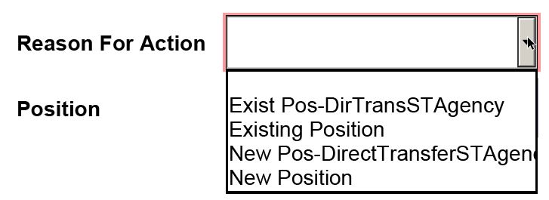
New Hire
  Choose the reason for the action, then click on Search Position button to select the correct position. After choosing the position number, click on Load Position Data.
    New Position -> Never had a holder
    Existing -> Previously held by another employee
    Direct Transfer -> Employee is transferring from another State Agency without a break in service, ex: left Friday and starting here Monday.
  The org data, supervisor, and supervisor’s position will load automatically based on the position data.

Slide 31
New Hire
  Additional information is entered in the PCR. If exact contact info is unknown, please fill with main department information. Do not leave blank. This is for the directory.

Slide 32
New Hire
  Comments Section of the PCR
  Include all information relevant to the hire.
  Posting # needs to be on the PCR. This number can be found in People Admin
  When using a Quick Hire or Quick Rehire for non-student, non-regular employees, you must indicate a statement that the criminal history has been completed and approved by HR.
  For Task Workers indicate the end date of task.

Slide 33
Rehire – Which PCR Do I Use?
  To select the correct PCR type you will have to run the ZHRPEOPLESEARCH to see what Payroll Area the last assignment was in.

Slide 34
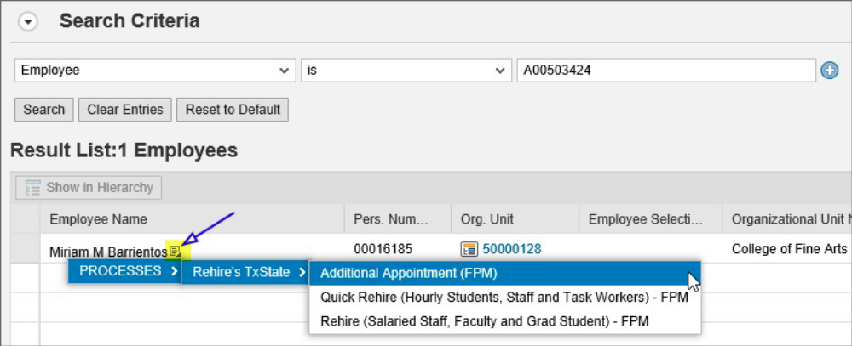
Rehire
  Rehire is selected to appoint an employee into a salaried position when the previous position held was salaried.
  Quick Rehire is selected to appoint an employee into an hourly or task position when the previous position held was hourly or task.
  Additional Appointment is selected to appoint an employee into a position in a payroll area different from the previous position held.

Slide 35
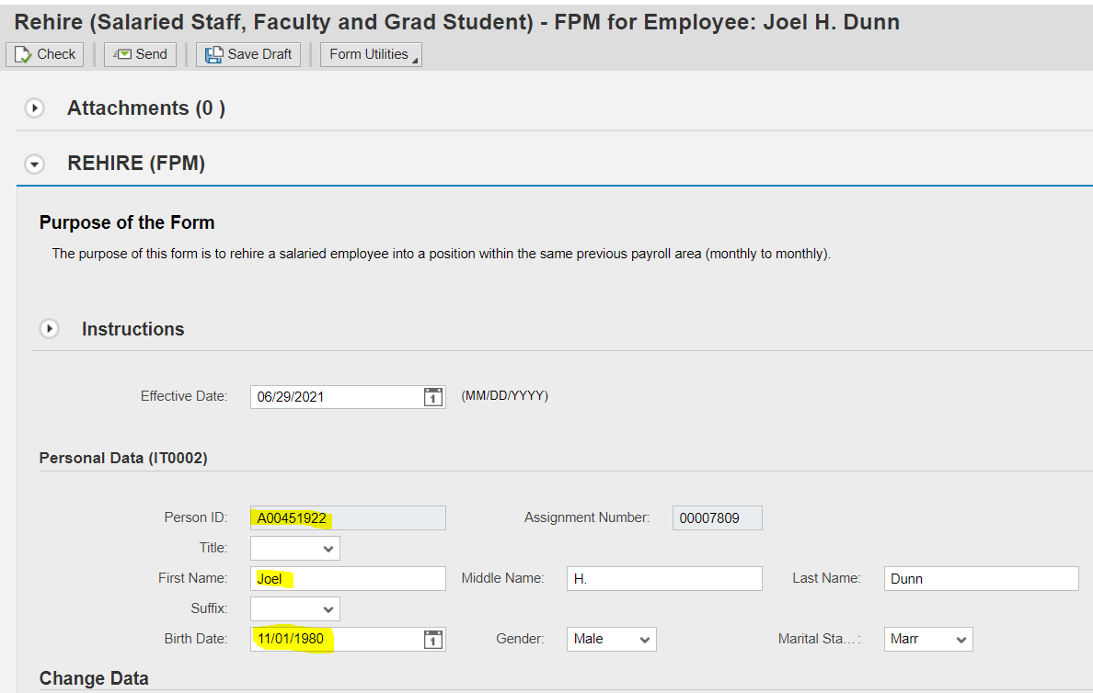
Rehire
  The employee’s information is pre-populated.

Slide 36
The Additional Appointment PCR
  The Additional Appointment PCR is used for the following purposes:
  To add an additional assignment for an employee;
  Change in position that requires a payroll area change (ex: hourly to salaried, non-pay to paid, etc.);
  Rehire an employee into a position that requires a payroll area change (ex: previous position was hourly, new position is salaried);
  Change in position with a change in FTE effective other than the 1st day of the month (staff only);
  Rehire an employee with a change in FTE from previous appointment, if the rehire is effective any day other than the 1st of the month (staff only).

Slide 37
Spilt Cost Distributions
  Electronic PCRs with split cost distributions will only flow to one account manager, the account with the highest percentage of costing. If the distributions are equal, the PCR will flow to the account manager listed first.
  Example: 30% Account Manager 1
  30% Account Manager 2
  30% Account Manager 3
  10% Account Manager 4
  This PCR will only flow to Account Manager 1.
  If approval is needed from other account managers, the initiator should obtain approval (via e-mail or some other means) and attach to the PCR when it is created.
  Example: 50% Account Manager 1
  50% Account Manager 2
  This PCR will only flow to Account Manager 1.

Slide 38
Special Payment PCRs with Spilt Cost Distributions
  One-time payment Special Payment PCRs can only be funded from one source of funds. Special payments funded from more than one source require a separate PCR for each account.
    Example: $1500 stipend split between two accounts (40/60 split).
  -One PCR for $600, 100% from account (XXXXX)
  -One PCR for $900, 100% from account (XXXXX)
  A recurring payment Special Payment PCR can only be funded from one source of funds (example: grant funded wireless allowance can only pay from one grant). Recurring payments funded from more than one source require a separate PCR for each account. NOTE: If funding from more than one source, the costing must remain in effect for the entire FY or requested period for payments. Change to dollar amount or funding source cannot be made once the initial actions have processed.

Slide 39
Special Payment PCRs – Wireless allowance
Wireless Cellular Communication Services Policy
Audited once a year and shared with VP Executive Assistant of each division.
PCRs cannot be retroactive.
Allowances can only be paid from one funding source.
PCRs must be submitted with an approved allowance form.
To change the cost distribution on an active allowance, a new PCR must be submitted. Please indicate the end date of the previous allowance and the new start date in the comments.
HR will end the allowance upon separation, reclassification, or change in position.
  A new PCR is needed to start the allowance again.
Allowances are setup to end 12/31/9999, unless specifically requested otherwise in PCR comments.
  A different end date usually relates to grants only.

Slide 40
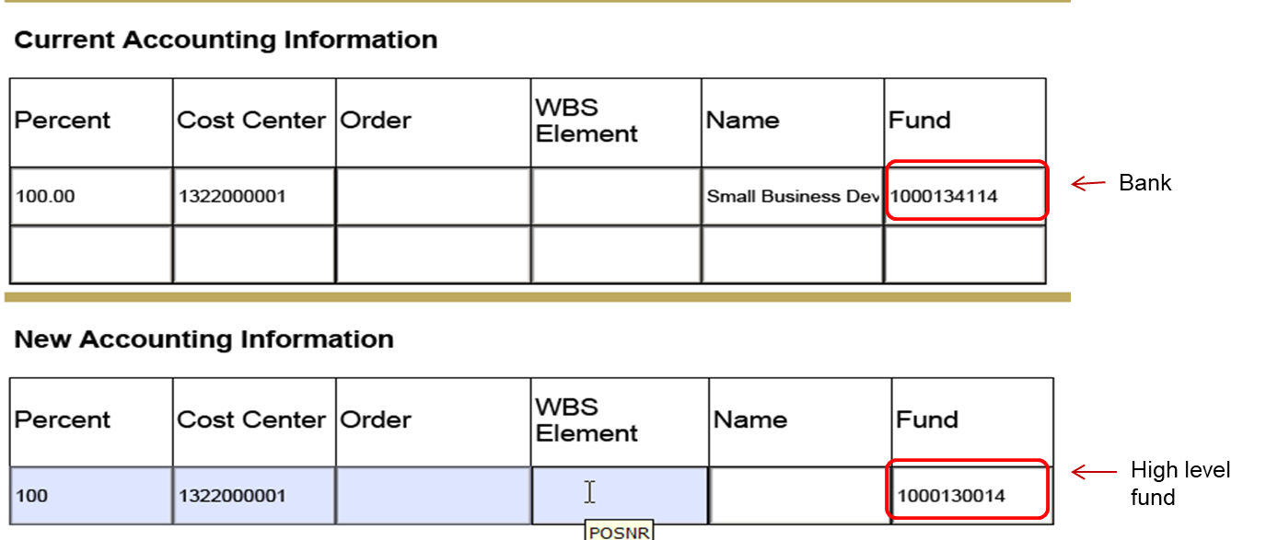
Helpful Information
  When entering an E&G fund, use the higher-level fund number. In this example, 1000050014 is the higher-level fund. The fund 1000054111 indicates the bank that is charged by accounting.
  The higher-level fund for this current fiscal year is 1000130022.

Slide 41
Helpful Reminders
  Employee appointments are open ended with no termination dates.
  The funding source for grant employees has an end date, however, a funding end date does not end an employee’s appointment or employment. If a department does not update the cost distribution for a grant funded employee once the grant has ended, the costing defaults to the 8999999999 fund.
  If a separation PCR is not prepared for a salaried employee, they will continue to be paid once they leave the university.
  A separation PCR is not prepared if an employee is changing departments unless there is a break in service. The department that is gaining the employee will prepare the appropriate PCR.
    Transfer guide can be found here: https://www.hr.txstate.edu/forms.html

Slide 42
Helpful Reminders
  For faculty and graduate students with <12-month appointments: A LWOP action is processed by Faculty and Academic Resources each year so faculty are not paid from the 9-month appointment during the summer. If a separation action is to be created for a faculty member or graduate student, the LWOP action must be removed first.
  Faculty or Graduate Students in Academic Affairs
    Elizabeth Mello, es15@txstate.edu
    Candice Satchell, cs49@txstate.edu
  Contact HR Data Management Team, HR_MDC@txstate.edu, for graduate students in all other divisions.
  You can check PA20 actions to see if the LWOP has been created.

Slide 43
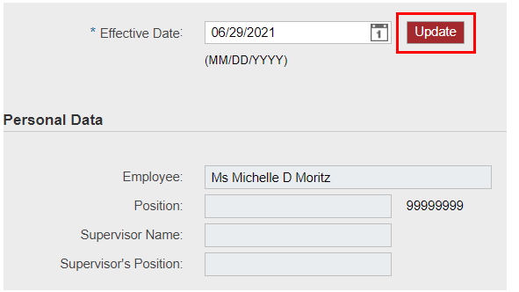
Helpful Information
  When the position is “loaded” the supervisor’s name will appear on most PCRs. If the supervisor’s name is incorrect, the initiator should verify that the correct position was selected. If a supervisor change is needed on a position, a Change in Supervisor Request Form should be submitted to the HR Data Management Team or Faculty and Academic Resources , as appropriate.
  Only the initiator can use the UPDATE button when the PCR is created. If the PCR is saved as a draft and the initiator uses the UPDATE button again, all information will be cleared on the form.

Slide 44
Understanding Electronic Workflow
  Once the initiator has created the PCR and clicked the SEND button, the electronic flow begins. Flow is determined by the accounting information that is provided on the PCR.
  Email notification is sent to the account manager for approval.
  The PCR will continue to flow to the next designated level for approval.
  Grant funded appointments flow to the Office of Sponsored Programs for approval.
  Salaried graduate student appointments flow to the Graduate College for approval.
  Change in Pay PCRs for staff employees with the reason of “Adjustment” flow to the VPFSS for approval before flowing to the HR Data Management Team for processing.

Slide 45
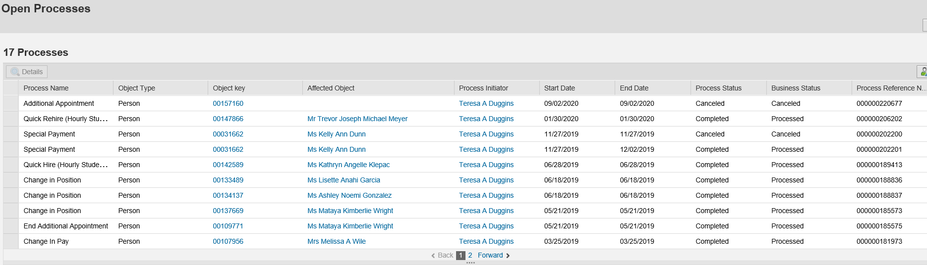
Tracking the Electronic PCR
  PCR initiators can track Electronic PCRs through the process.
  Log into the SAP Portal.
  Click on the View My PCR’s under the Manage PCRs tile.
  Use the SAP GUI transaction ZWFHCM6

Slide 46
Tracking the Electronic PCR
  Process Status
  In process – the PCR is still flowing through electronic workflow;
  Completed – the PCR has been processed by the processing office (either Faculty and Academic Resources or the HR Data Management Team) and the changes can be seen in the SAP GUI PA20;
  Canceled – the initiator withdrew the PCR before it was processed by Faculty and Academic Resources or the HR Data Management Team;
  Rejected – the PCR was rejected either by an approver or the processing office.
  **Most rejected PCRs can be sent forward again.

Slide 47
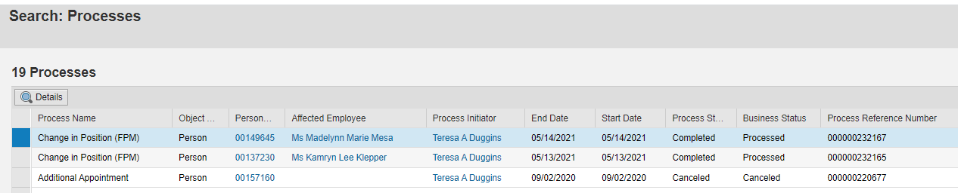
Tracking the Electronic PCR
  The initiator can select a PCR by clicking on the box next to the Process Name and clicking the Details button.

Slide 48
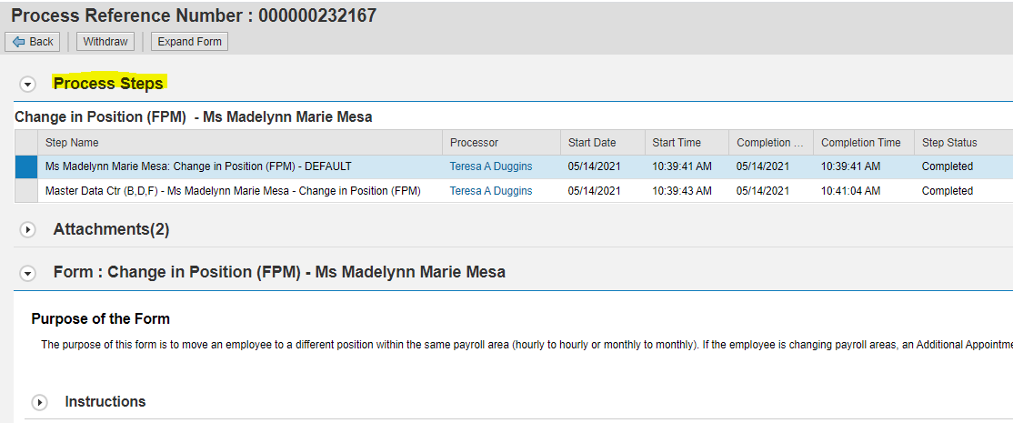
Tracking the Electronic PCR
  The PCR will open at the top of the form under Process Steps, you can see everyone involved in the processing of the PCR .
  The initiator can withdraw a PCR prior to final processing by Faculty and Academic Resources or the HR Data Management Team.

Slide 49
Resubmitting a Rejected PCR
  A Rejected PCR will return to My Inbox in the SAP Portal with comments from HR as to what caused the rejection.
  A rejected PCR can be corrected and resubmitted through workflow. Attachments can also be corrected.
  A WITHDRAW button will now appear on the form once it is rejected. This withdraw button is used to withdraw a rejected PCR that will not be resubmitted through workflow.
  If a PCR was rejected because it was the incorrect type of PCR form, the form must be withdrawn, and a new PCR is required. The form cannot be resubmitted.
  The rejected Additional Appointment PCR cannot be resubmitted if an incorrect position number was used. A new PCR is required.
  A rejected New Hire PCR can be resubmitted with a corrected position number.

Slide 50
Possible Reasons for Resubmitting a Rejected PCR
  Add incorrect or forgotten attachments
  Change in cost distribution
  Change in action reason code (not type of PCR form)
  Change in FTE
  Change in effective date
  Change in monthly salary

Slide 51
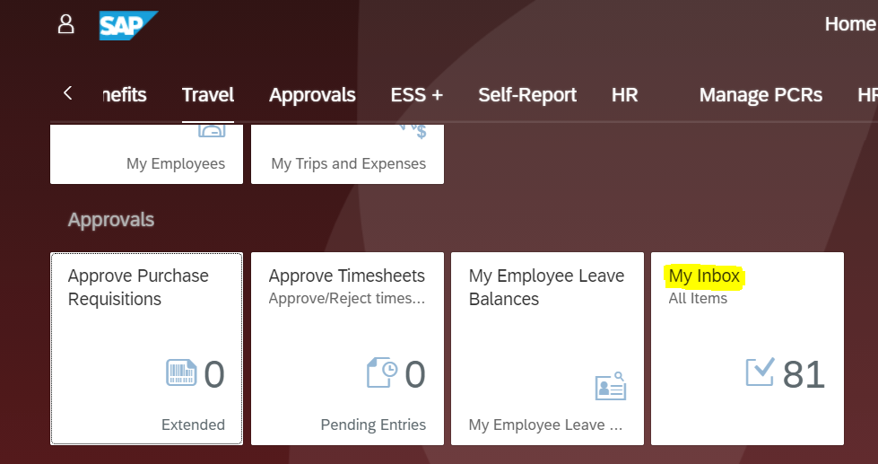
Rejected PCR in “My Inbox”
  When a PCR is rejected it is returned to the initiator’s “My Inbox” under the “Approval” section

Slide 52
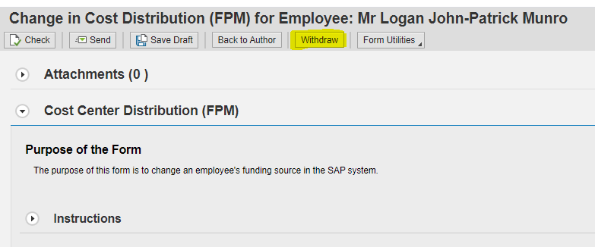
Which Withdraw Button to Use?
  Withdraw option via “My Inbox”
    This option is used when the PCR is in your “Inbox”
    Used when a PCR has been rejected and you do NOT want to correct and resubmit the form. This option removes the form from the workflow.

Slide 53
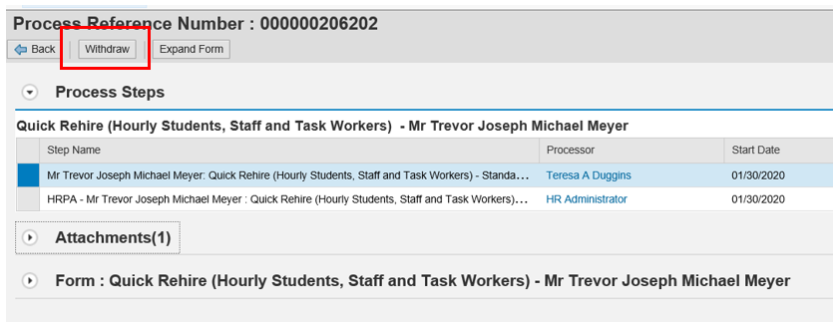
Withdraw Option via View My PCR’s
  Withdraw option via HCM Processes and Overview
    This option is used when the PCR is currently in workflow and is NOT in your SAP Portal My Inbox tile.
    If the initiator created and resubmitted a PCR, then wishes to withdraw it prior to final processing.

Slide 54
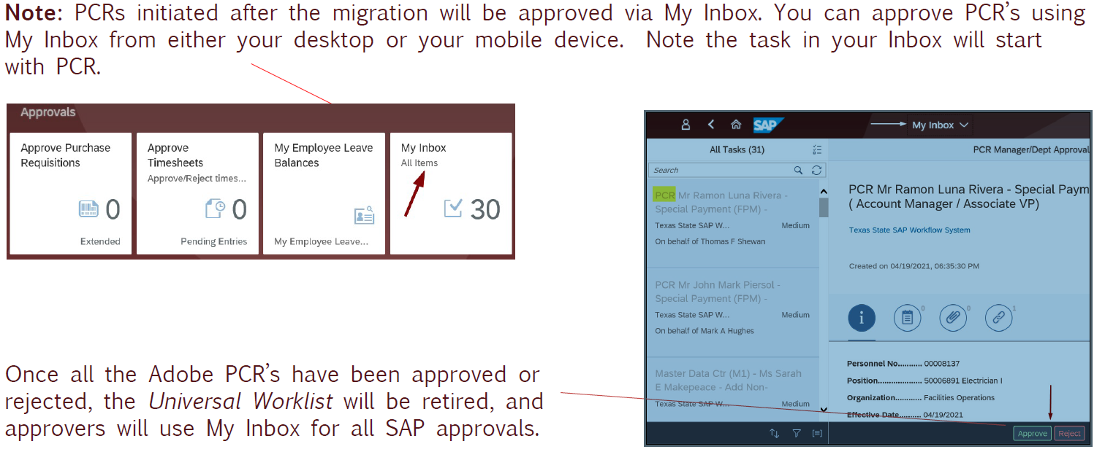
Approver’s “My Inbox” Contents

Slide 55
Substitution for Approvers in SAP Workflow
  SAP Workflow Task Substitution allows task owners to designate a substitute on the Portal My Inbox tasks on their behalf. A substitute must have the appropriate SAP security role to support the substituted activity.
  The initiator cannot serve as a substitute for approval purposes.
  All approvers should have a substitute in case of emergencies. Without a substitute, PCR’s might get stuck in someone’s approval workflow during an absence. When PCRs get stuck in the workflow, it slows up processing time.
  Substitution in SAP Instructions Click on PCR Guides and open “My Inbox User Guide”

Slide 56
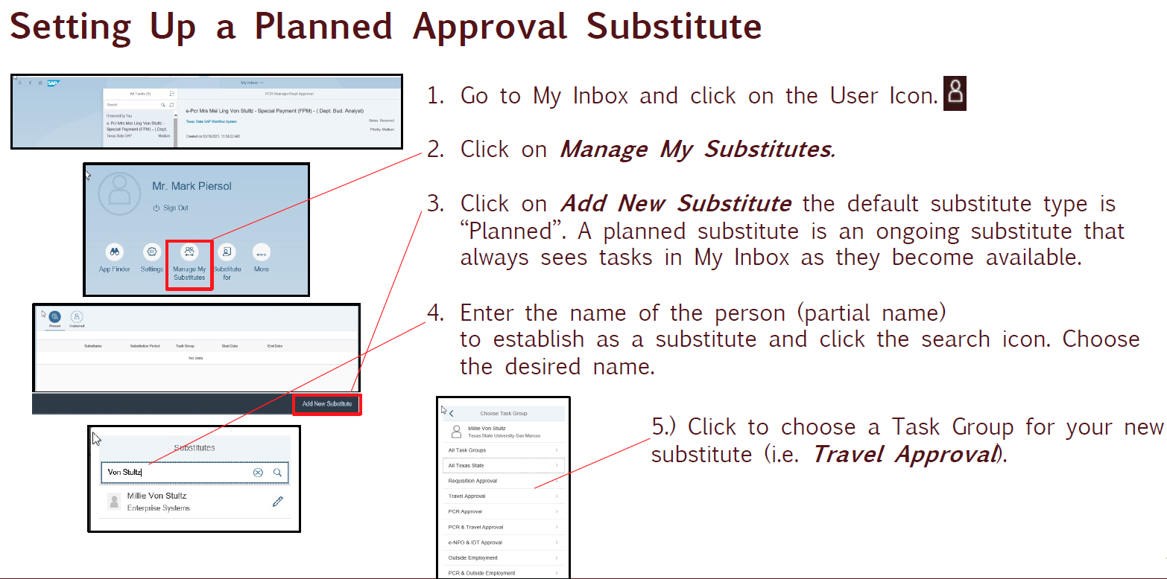

Slide 57
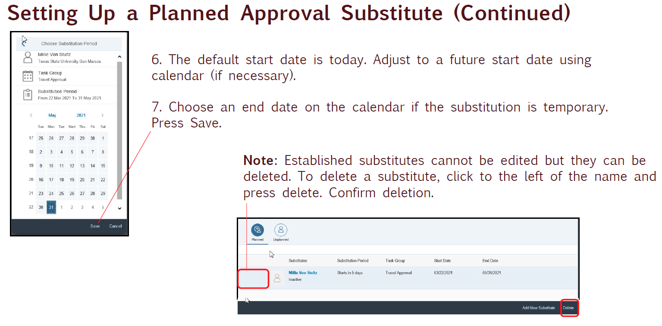

Slide 58
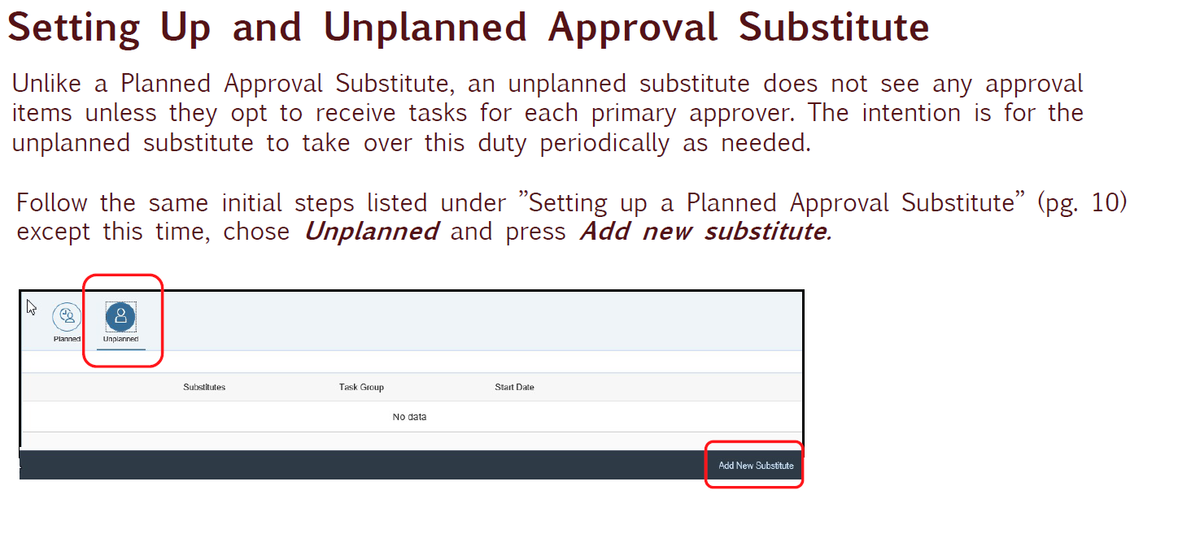

Slide 59
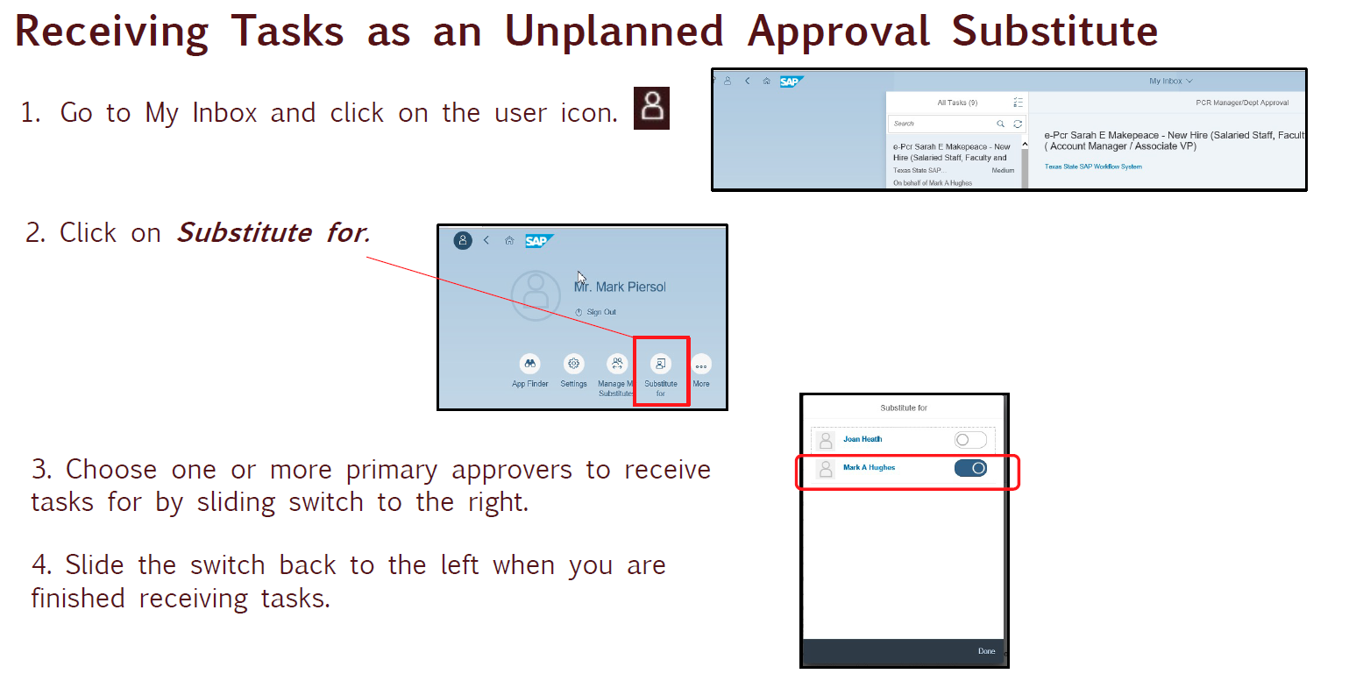

Slide 60
SAP Security Role Review Policy and Procedures
  Supervisors are responsible for monitoring and requesting adjustments to security roles as job responsibilities change throughout the year.
  SAP security roles must be verified on an annual basis.
  Supervisors are responsible for certifying the roles currently assigned to their direct reports. Supervisors will receive a task in their SAP My Inbox to initiate the certification process.
  If it is determined that a role needs revocation, it is possible to indicate this in the certification process and eliminate the need to submit a revocation security form to ITAC.

Slide 61
SAP Security Role Review Policy and Procedures Questions & Instructions
  Finance roles:
    Financial Reporting, gao@txstate.edu or 245.2541
  Human Resources roles for Academic Affairs:
    Faculty and Academic Resources, facultyresources@txstate.edu or 245.2786
  Human Resources roles for all other divisions:
    Human Resources, Data Management Team, hr_mdc@txstate.edu or 245.2557
    Instructions for Certifying SAP Security Role Assignments

Slide 62
Position Based Training
  Training will now be identified using the position or job number assigned in SAP
  Positions with relationships to designated training classes will be identified when an employee is placed into the selected position. The employee will be notified to register for the specified training and will continue to receive the notice until they complete the training. Their supervisor will also receive reminder emails.
  When an employee separates from Tx State or transfers between departments, the employee will still be flagged for training if they are out of compliance until they are removed from their position by the losing department.
    Ex: If Joe Smith works in a lab and handles hazardous waste; the position he is assigned to will be flagged as needing this training. If Joe leaves, he will continue to be notified until his PCR is processed. The employee who replaces him will then be notified and required to take the training.

Slide 63
Required Training
  Designated positions in applicable departments require training for selected holders.
  Through a campus-wide Licensing and Credential initiative, Texas State University is currently in the process of transitioning all safety training previously administered through TRACS onto SAP.
  Required training is coded with A031 on positions and can be viewed with PO13D.
  Examples of Required Training: Hazardous Waste Certification, Spill Prevention Control and Countermeasures
  For questions concerning training content or why you are being asked to take the training, please contact the Environmental Health Safety and Risk Management office at ehs@txstate.edu.
  Environmental Health, Safety & Risk Management Training

Slide 64
Required Licenses, Certifications and Credentials (LCC)
  Designated positions and/or job codes require certain Licenses, Certifications and Credentials due to their job duties.
  SAP automatically sends notices on the 1st of the month to the employee and employee’s supervisor to remind the employee to complete the required certification or license. The notices will continue until training is complete.
  LCC’s are coded as AZ12 on positions and can be viewed with PO13D.
  Example of LCC’s: Basic Peace Officer, Master Peace Officer, Registered Nurse
  For questions concerning LCCs, please contact Human Resources at hr@txstate.edu.

Slide 65
Additional LCC and Required Training Info
  Before hiring an employee, check the position number for the training indicator. Only put employees whose job will require that training or LCC in that position number.
  Check positions for A031 & AZ12 indicators with PO13D or ZHRPOSRPT.
    How to find A031 and AZ12 on positions
  If you think an employee needs to be trained, but their position has not been flagged for that training, contact the office of Environmental Health, Safety & Risk Management to add the indicator to their position number.
  If an employee’s job requires an LCC, but their position has not been flagged for that indicator, please contact HR.
  When an employee leaves, ensure PCRs are submitted as soon as possible to avoid notifying employees who have left the University or transferred departments.

Slide 66
Important Security Note
Electronic attachments containing confidential information must be deleted from electronic storage (e.g., your hard drive) once they are uploaded/attached in the HireRight system or PCR.
  Examples include scanned copies of birth certificates, social security cards, driver licenses, W-4 and other personally identifying documents, etc.
  You should never e-mail confidential information.
  File and Data Storage and Sharing information is provided by ITAC:
    https://itac.txstate.edu/support/datamanagement-guide/store-share.html

Slide 67
Additional Recommended Training
If you will be initiating PCRs for Faculty, please reach out to Faculty and Academic Resources to schedule training.
If you will be the time administrator for your department, please reach out to hr@txstate.edu to schedule training.
To further your knowledge in SAP Organizational Management, sign up for Understanding Organizational Management training through the Success Factors Learning tile in the SAP Portal. This training is not required, but compliments PCR training.

Slide 68
Questions
  HR Data Management Team
  Katie Bonner | HRIS Manager | (kb1367) – Salaried staff and graduate student PCR processing
  Teresa Duggins | HRIS Analyst | (td01) – Non regular, non student PCR processing
  Lisa Gonzalez | HRIS Analyst | (lv04) – Hourly student appointment processing
  Lori Kinser | HRIS Representative| (lk1069) – Employment verifications, open-records, i2Verify, PCR and org backup
  General contact: hr_mdc@txstate.edu
  Faculty and Academic Resources
  New Faculty Hires, Faculty, Program Faculty, and Graduate student PCR processing for specific colleges
  Elizabeth Mello | Sr Faculty Analyst | (es15)
  Candice Satchell | Faculty Analyst | (cs49)
  https://facultyresources.provost.txstate.edu/PCR-Resources.html

Slide 69


